Slide 1
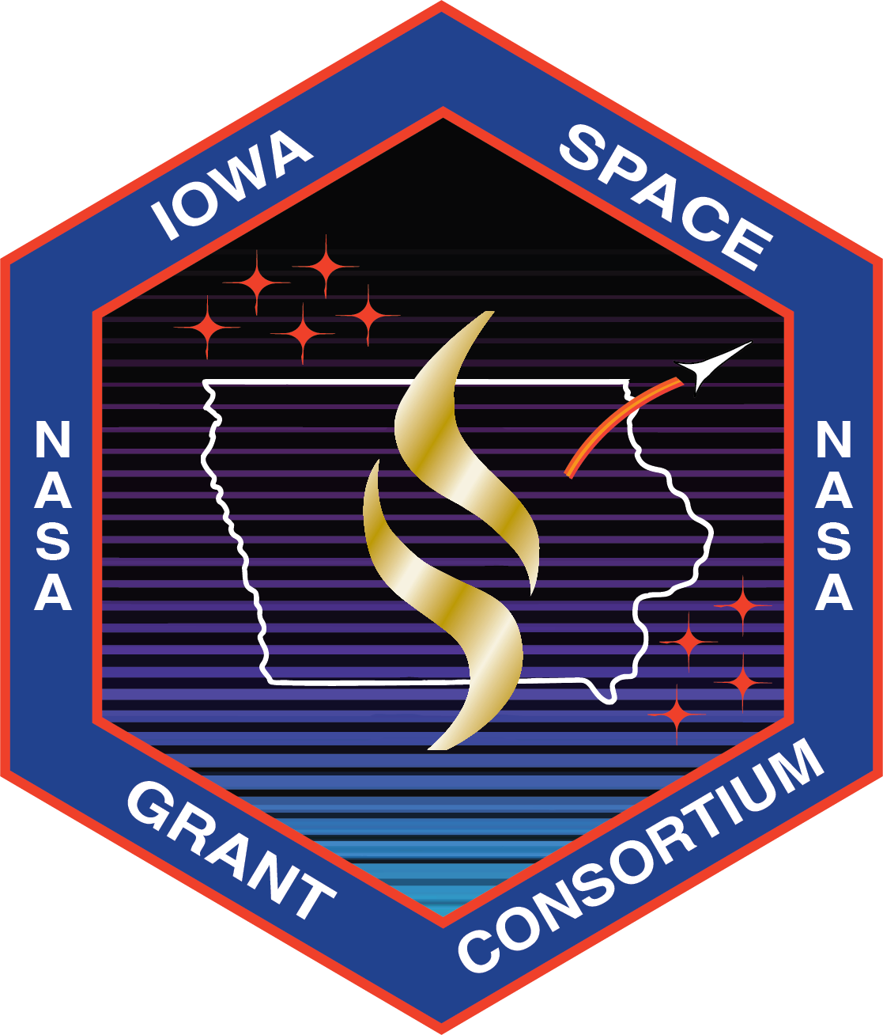
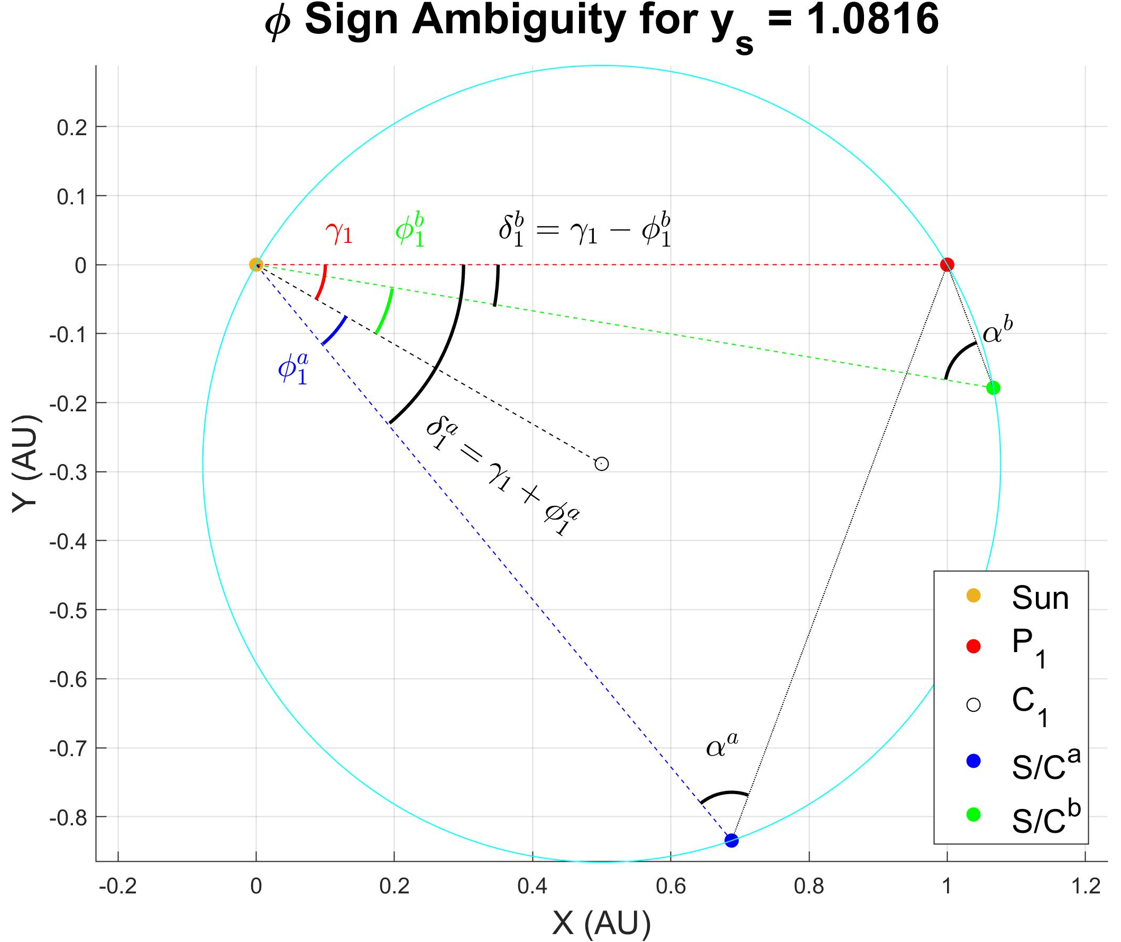
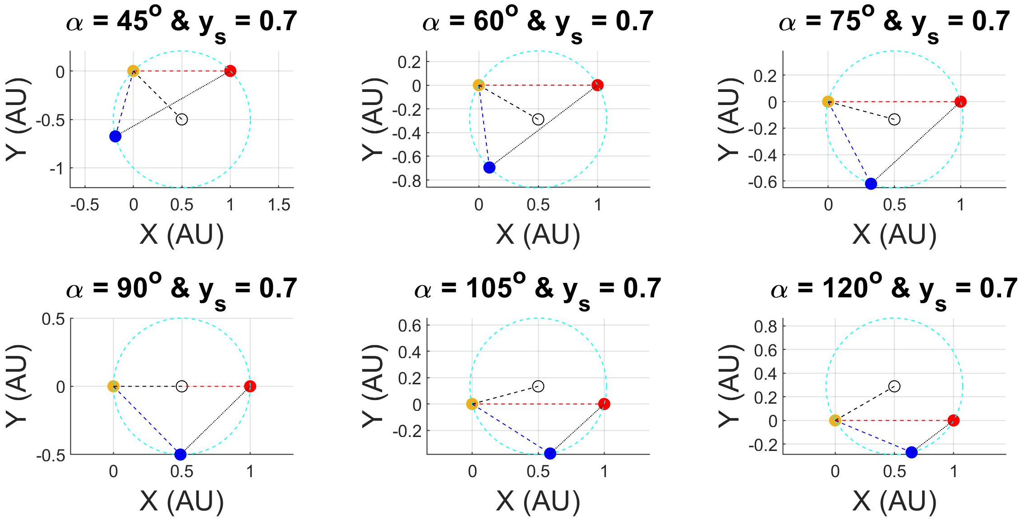
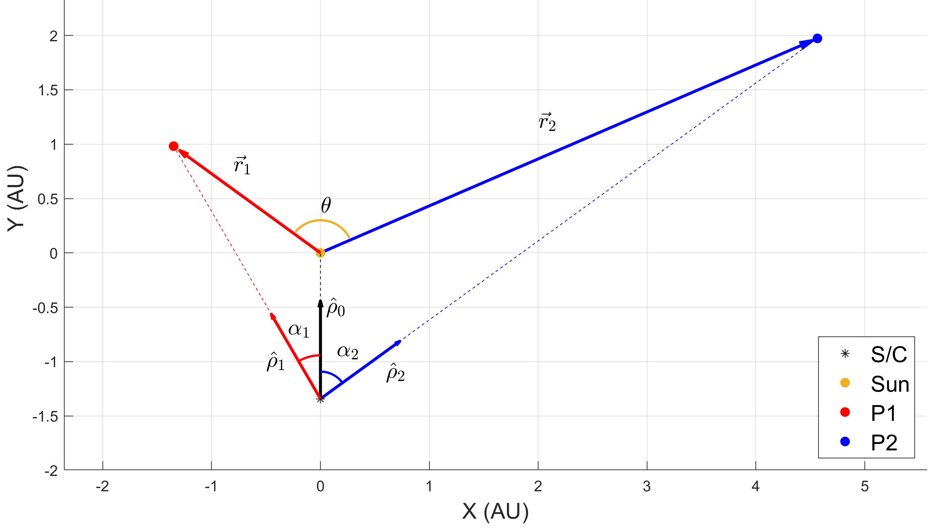
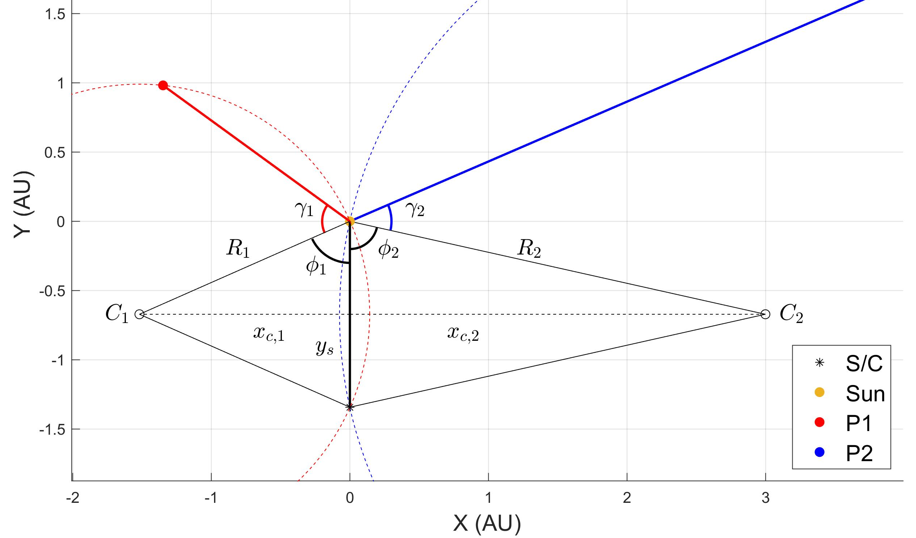
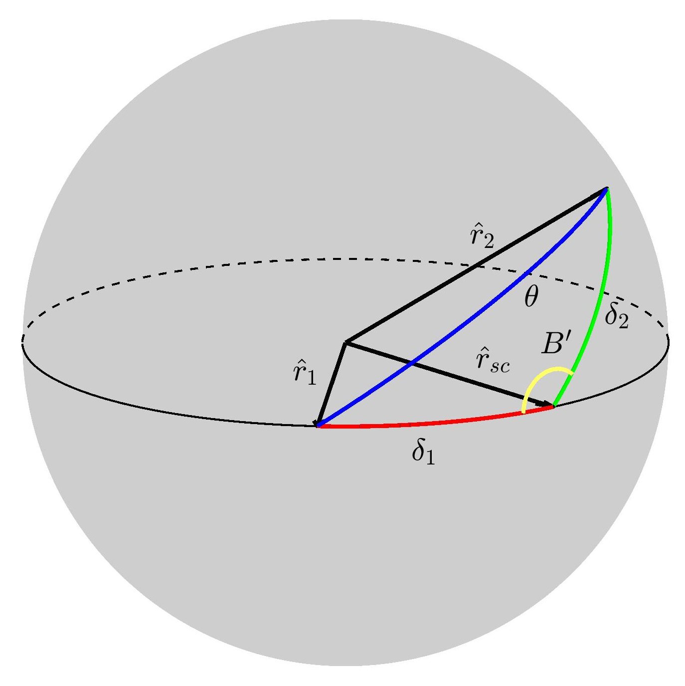


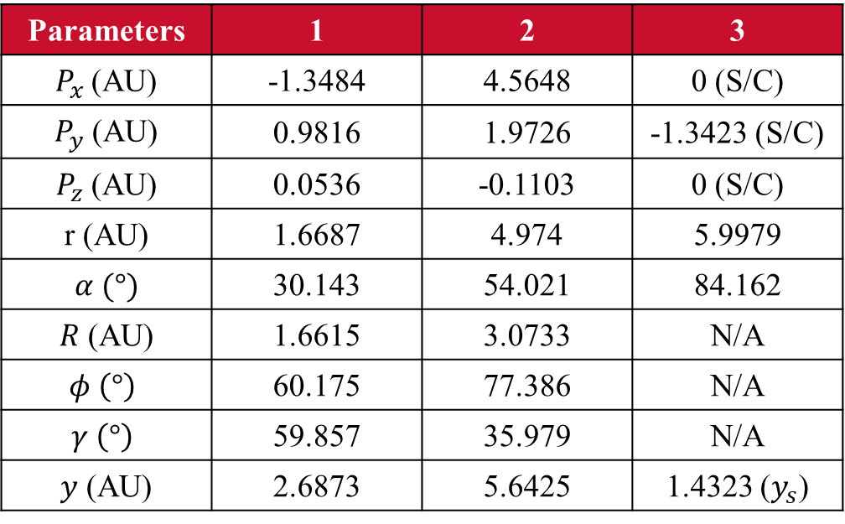
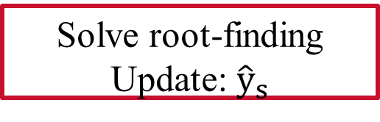




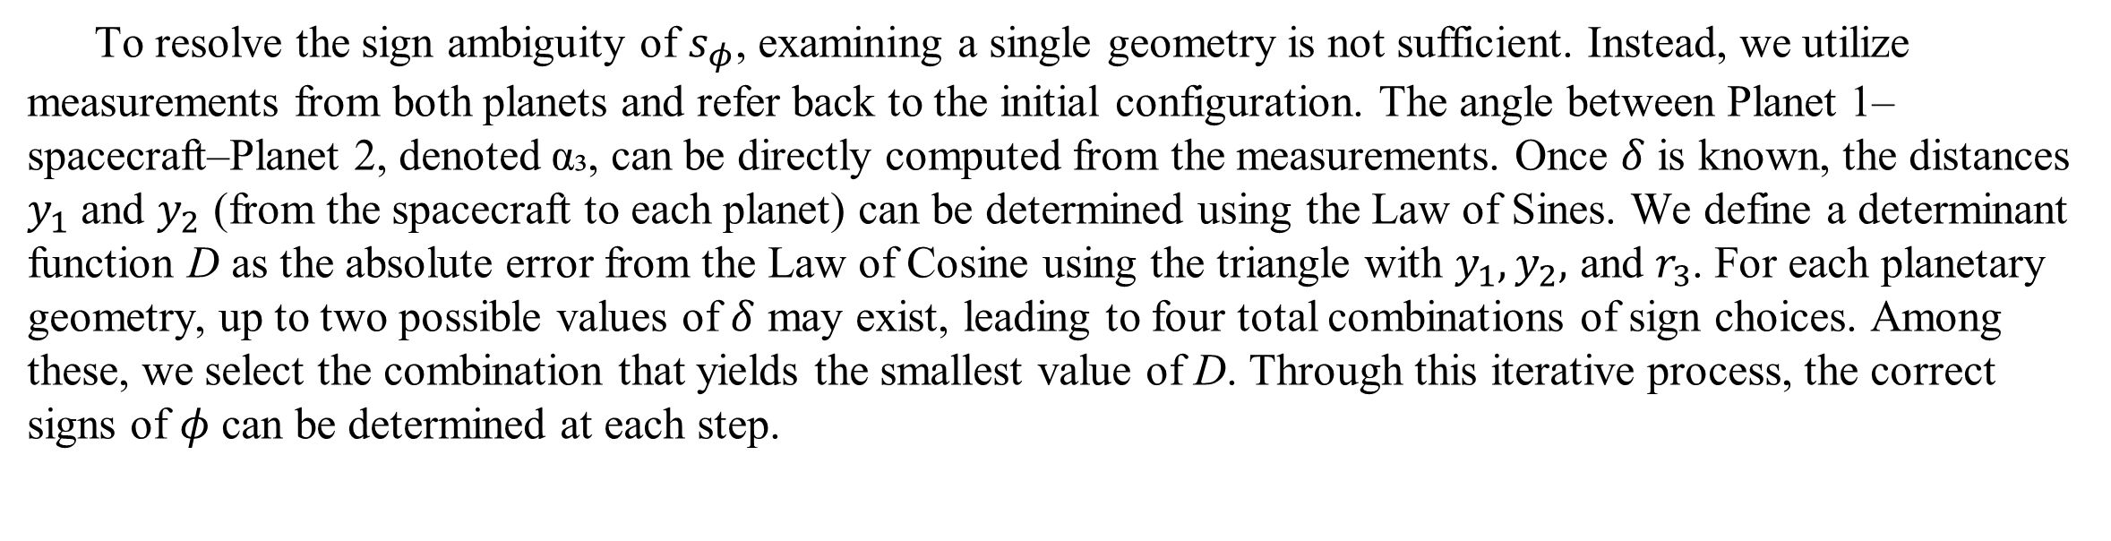
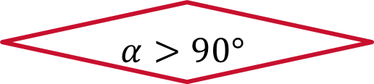



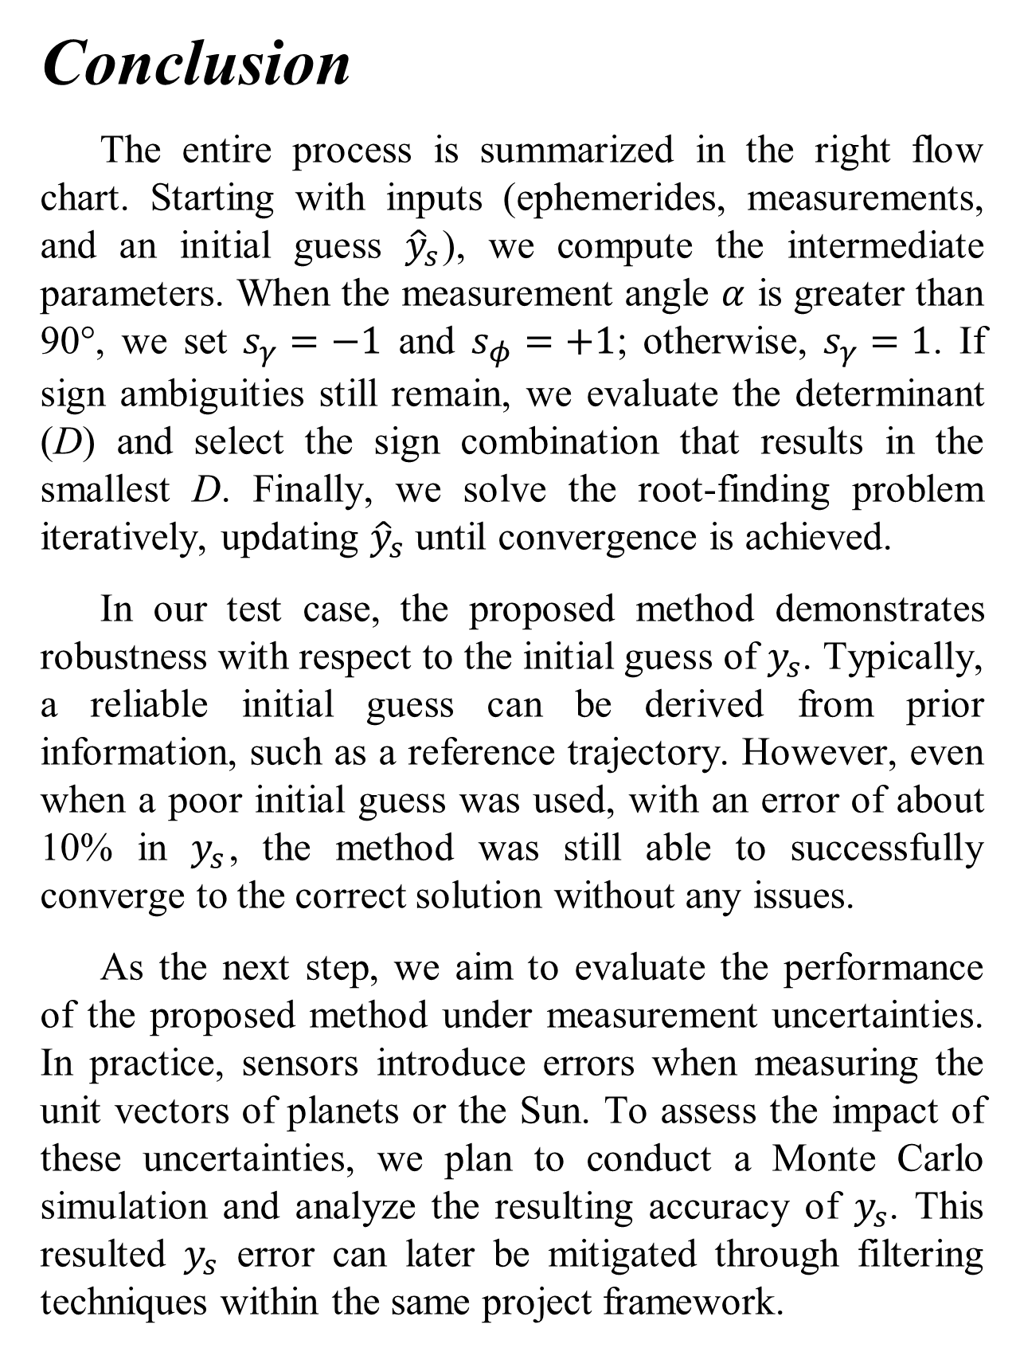
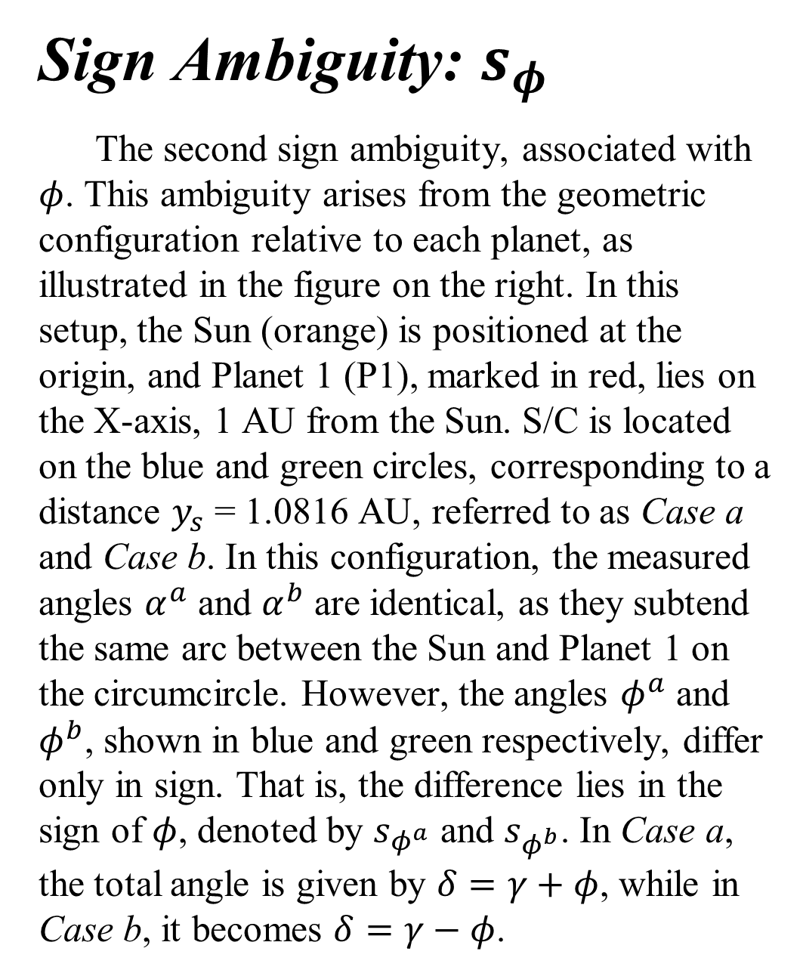


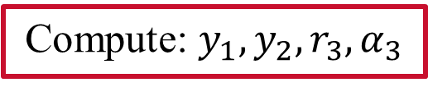



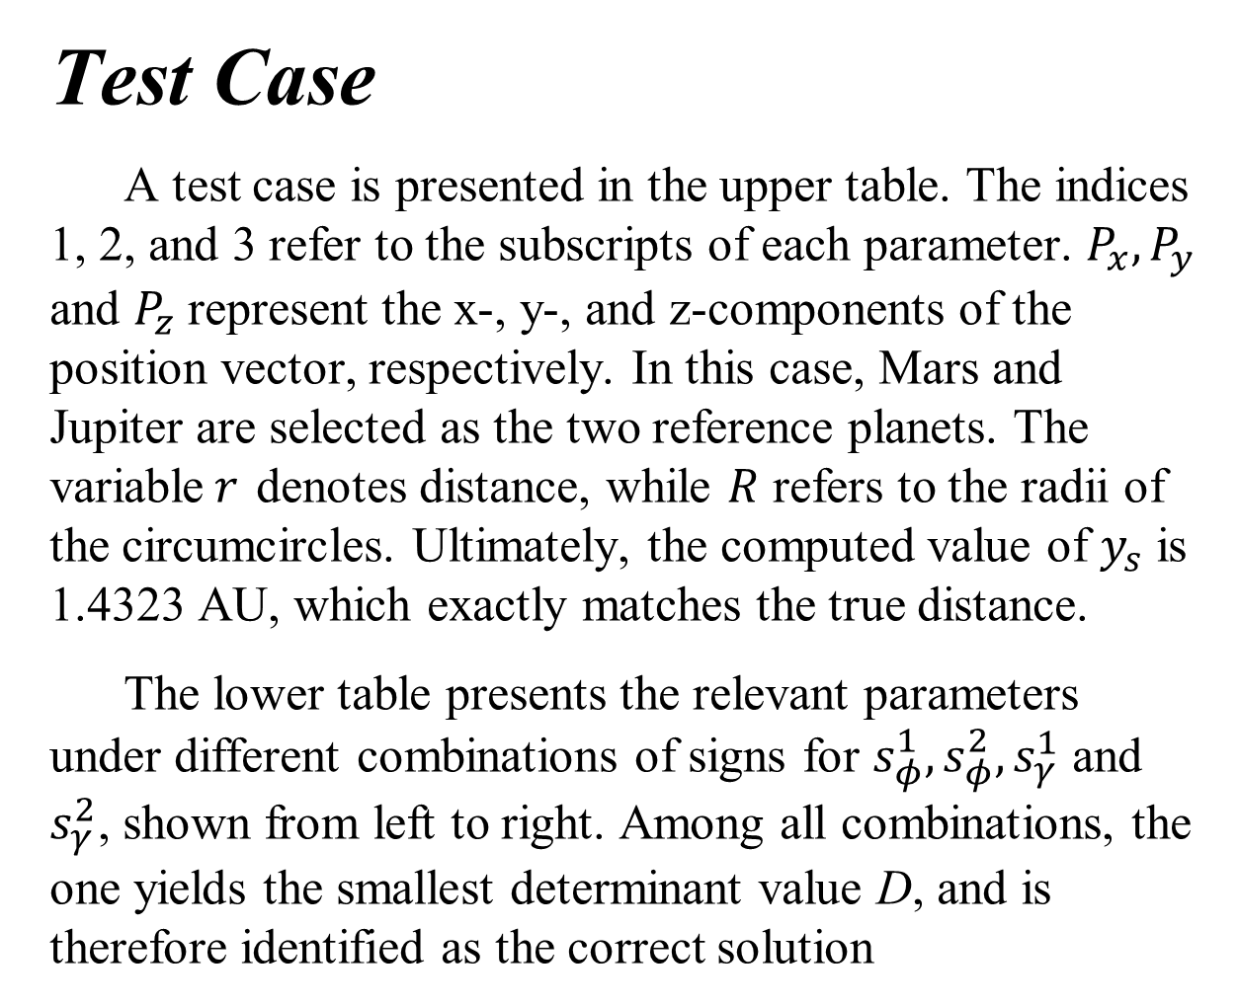
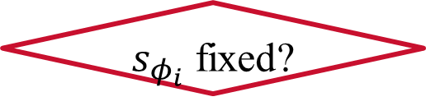

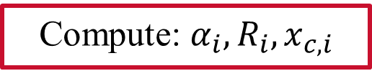
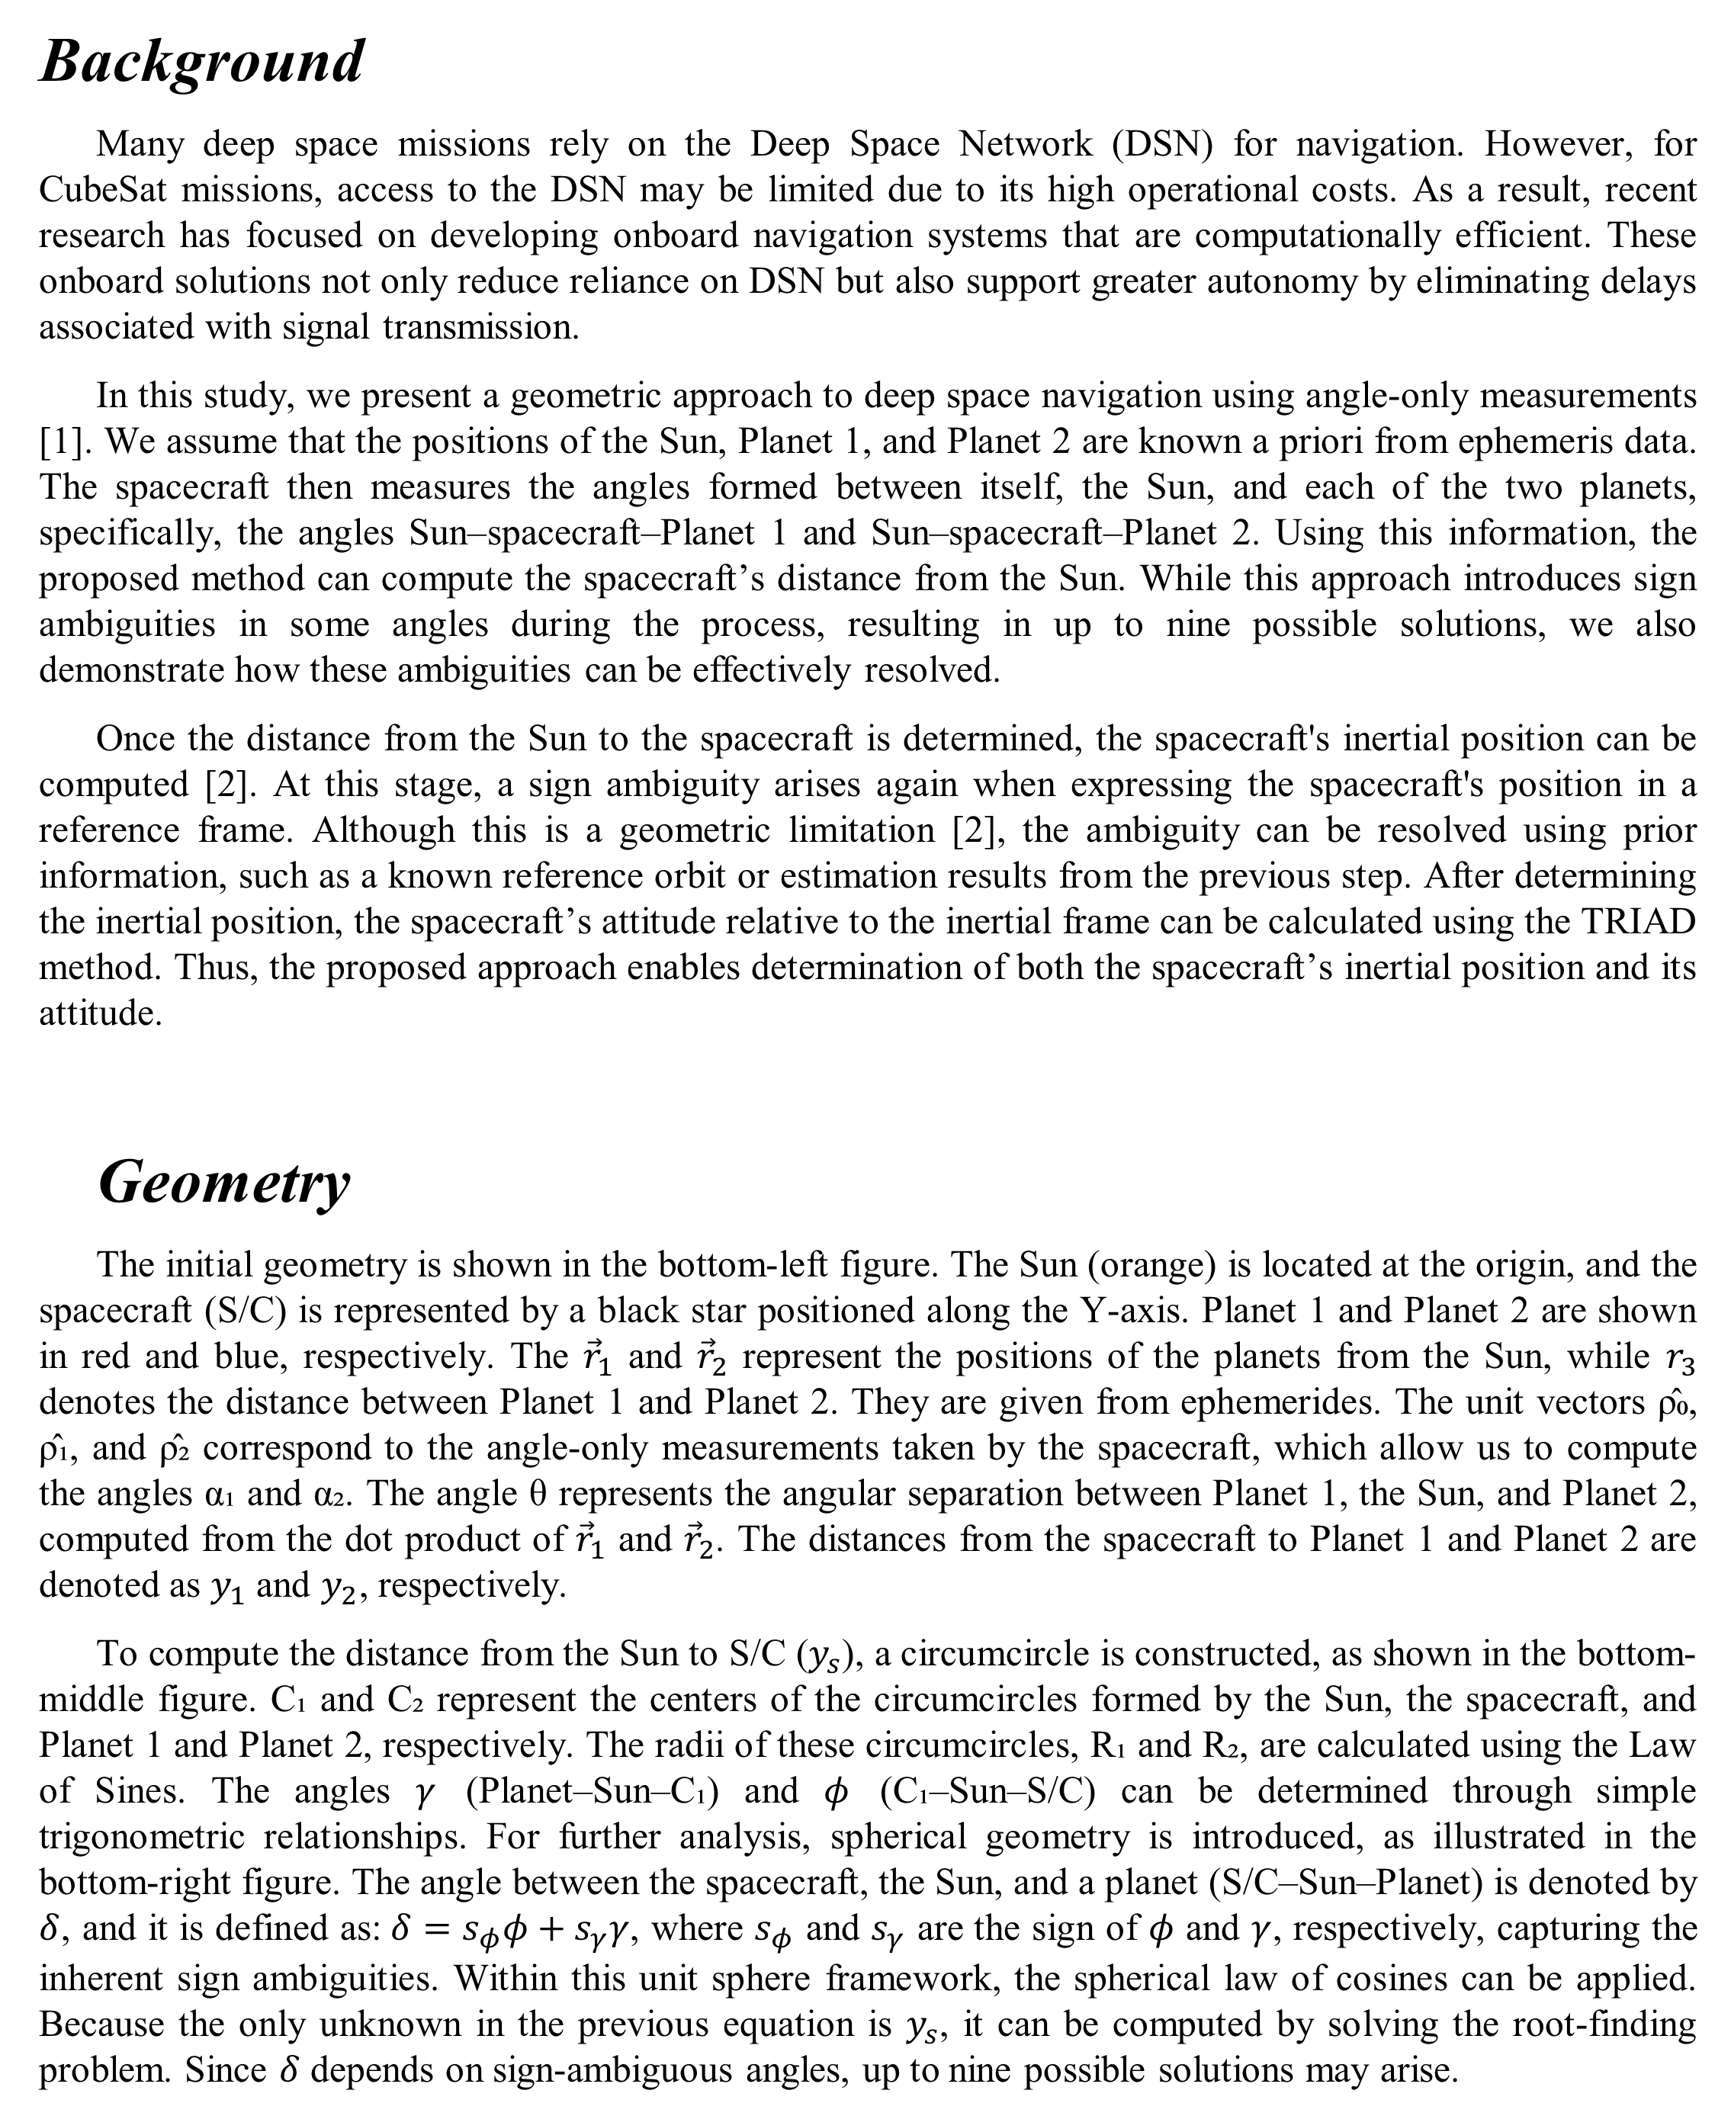


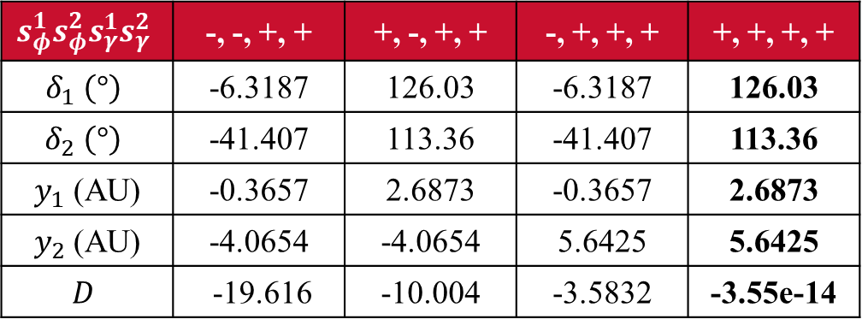



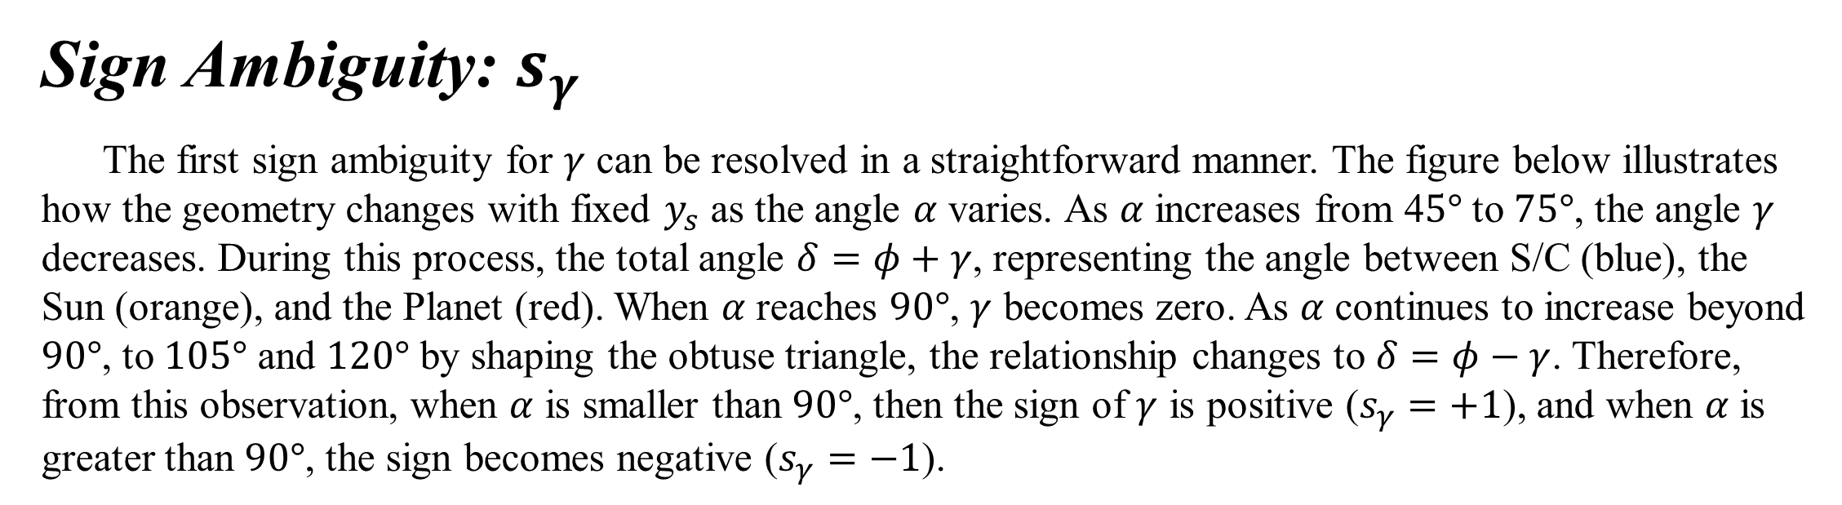
Department of Aerospace Engineering
Iowa Space Grant Consortium Student Research Symposium
April 15, 2025
Sungmoon Choi, Ph.D. Candidate Faculty Advisor: Ossama Abdelkhalik, Professor, Vance D. Coffman Faculty Chair
Ambiguity-Free Geometrical Deep Space Navigation Using Angle-Only Measurements
Background
Many deep space missions rely on the Deep Space Network (DSN) for navigation. However, for CubeSat missions, access to the DSN may be limited due to its high operational costs. As a result, recent research has focused on developing onboard navigation systems that are computationally efficient. These onboard solutions not only reduce reliance on DSN but also support greater autonomy by eliminating delays associated with signal transmission.
In this study, we present a geometric approach to deep space navigation using angle-only measurements [1]. We assume that the positions of the Sun, Planet 1, and Planet 2 are known a priori from ephemeris data. The spacecraft then measures the angles formed between itself, the Sun, and each of the two planets, specifically, the angles Sun–spacecraft–Planet 1 and Sun–spacecraft–Planet 2. Using this information, the proposed method can compute the spacecraft’s distance from the Sun. While this approach introduces sign ambiguities in some angles during the process, resulting in up to nine possible solutions, we also demonstrate how these ambiguities can be effectively resolved.
Once the distance from the Sun to the spacecraft is determined, the spacecraft's inertial position can be computed [2]. At this stage, a sign ambiguity arises again when expressing the spacecraft's position in a reference frame. Although this is a geometric limitation [2], the ambiguity can be resolved using prior information, such as a known reference orbit or estimation results from the previous step. After determining the inertial position, the spacecraft’s attitude relative to the inertial frame can be calculated using the TRIAD method. Thus, the proposed approach enables determination of both the spacecraft’s inertial position and its attitude.
Geometry
The initial geometry is shown in the bottom-left figure. The Sun (orange) is located at the origin, and the spacecraft (S/C) is represented by a black star positioned along the Y-axis. Planet 1 and Planet 2 are shown in red and blue, respectively. The ${\vec{r}}_{1}$ and ${\vec{r}}_{2}$ represent the positions of the planets from the Sun, while $r_{3}$ denotes the distance between Planet 1 and Planet 2. They are given from ephemerides. The unit vectors ρ̂₀, ρ̂₁, and ρ̂₂ correspond to the angle-only measurements taken by the spacecraft, which allow us to compute the angles α₁ and α₂. The angle θ represents the angular separation between Planet 1, the Sun, and Planet 2, computed from the dot product of ${\vec{r}}_{1}$ and ${\vec{r}}_{2}$. The distances from the spacecraft to Planet 1 and Planet 2 are denoted as $y_{1}$ and $y_{2}$, respectively.
To compute the distance from the Sun to S/C ($y_{s}$), a circumcircle is constructed, as shown in the bottom-middle figure. C₁ and C₂ represent the centers of the circumcircles formed by the Sun, the spacecraft, and Planet 1 and Planet 2, respectively. The radii of these circumcircles, R₁ and R₂, are calculated using the Law of Sines. The angles $γ$ (Planet–Sun–C₁) and $φ$ (C₁–Sun–S/C) can be determined through simple trigonometric relationships. For further analysis, spherical geometry is introduced, as illustrated in the bottom-right figure. The angle between the spacecraft, the Sun, and a planet (S/C–Sun–Planet) is denoted by $δ$, and it is defined as:$δ=s_{φ}φ+s_{γ}γ$, where $s_{φ}$ and $s_{γ}$ are the sign of $φ$ and $γ$, respectively, capturing the inherent sign ambiguities. Within this unit sphere framework, the spherical law of cosines can be applied. Because the only unknown in the previous equation is $y_{s}$, it can be computed by solving the root-finding problem. Since $δ$ depends on sign-ambiguous angles, up to nine possible solutions may arise.
Sign Ambiguity: $s_{γ}$
The first sign ambiguity for $γ$ can be resolved in a straightforward manner. The figure below illustrates how the geometry changes with fixed $y_{s}$ as the angle $α$ varies. As $α$ increases from 4$5°$ to $75°$, the angle $γ$ decreases. During this process, the total angle $δ=φ+γ$, representing the angle between S/C (blue), the Sun (orange), and the Planet (red). When $α$ reaches $90°$, $γ$ becomes zero. As $α$ continues to increase beyond $90°$, to $105°$ and $120°$ by shaping the obtuse triangle, the relationship changes to $δ=φ−γ$. Therefore, from this observation, when $α$ is smaller than $90°$, then the sign of $γ$ is positive ($s_{γ}=+1$), and when $α$ is greater than $90°$, the sign becomes negative ($s_{γ}=−1$).
Sign Ambiguity: $s_{φ}$
The second sign ambiguity, associated with $φ$. This ambiguity arises from the geometric configuration relative to each planet, as illustrated in the figure on the right. In this setup, the Sun (orange) is positioned at the origin, and Planet 1 (P1), marked in red, lies on the X-axis, 1 AU from the Sun. S/C is located on the blue and green circles, corresponding to a distance $y_{s}$ = 1.0816 AU, referred to as Case a and Case b. In this configuration, the measured angles $α^{a}$ and $α^{b}$ are identical, as they subtend the same arc between the Sun and Planet 1 on the circumcircle. However, the angles $φ^{a}$ and $φ^{b}$, shown in blue and green respectively, differ only in sign. That is, the difference lies in the sign of $φ$, denoted by $s_{φ^{a}}$ and $s_{φ^{b}}$. In Case a, the total angle is given by $δ=γ+φ$, while in Case b, it becomes $δ=γ−φ$.
$$γ$$
$$γ$$
$$γ$$
$$φ$$
$$φ$$
$$φ$$
To resolve the sign ambiguity of $s_{φ}$, examining a single geometry is not sufficient. Instead, we utilize measurements from both planets and refer back to the initial configuration. The angle between Planet 1–spacecraft–Planet 2, denoted α₃, can be directly computed from the measurements. Once $δ$ is known, the distances $y_{1}$ and $y_{2}$ (from the spacecraft to each planet) can be determined using the Law of Sines. We define a determinant function D as the absolute error from the Law of Cosine using the triangle with $y_{1},y_{2},$ and $r_{3}$. For each planetary geometry, up to two possible values of $δ$ may exist, leading to four total combinations of sign choices. Among these, we select the combination that yields the smallest value of D. Through this iterative process, the correct signs of $φ$ can be determined at each step.
$$γ$$
$$γ$$
$$φ$$
$$φ$$
$$φ$$
Test Case
A test case is presented in the upper table. The indices 1, 2, and 3 refer to the subscripts of each parameter. $P_{x}, P_{y}$ and $P_{z}$ represent the x-, y-, and z-components of the position vector, respectively. In this case, Mars and Jupiter are selected as the two reference planets. The variable$r$ denotes distance, while $R$ refers to the radii of the circumcircles. Ultimately, the computed value of $y_{s}$ is 1.4323 AU, which exactly matches the true distance.
The lower table presents the relevant parameters under different combinations of signs for $s_{φ}^{1}, s_{φ}^{2}, s_{γ}^{1}$ and $s_{γ}^{2}$, shown from left to right. Among all combinations, the one yields the smallest determinant value D, and is therefore identified as the correct solution
Parameters | 1 | 2 | 3
$P_{x}$ (AU) | -1.3484 | 4.5648 | 0 (S/C)
$P_{y}$ (AU) | 0.9816 | 1.9726 | -1.3423 (S/C)
$P_{z}$ (AU) | 0.0536 | -0.1103 | 0 (S/C)
r (AU) | 1.6687 | 4.974 | 5.9979
$α (°)$ | 30.143 | 54.021 | 84.162
$R$ (AU) | 1.6615 | 3.0733 | N/A
$$φ \left(°\right)$$ | 60.175 | 77.386 | N/A
$$γ \left(°\right)$$ | 59.857 | 35.979 | N/A
$y$ (AU) | 2.6873 | 5.6425 | 1.4323 ($y_{s}$)
Conclusion
The entire process is summarized in the right flow chart. Starting with inputs (ephemerides, measurements, and an initial guess ${\hat{y}}_{s}$), we compute the intermediate parameters. When the measurement angle $α$ is greater than 90°, we set $s_{γ}=−1$ and $s_{φ}=+1$; otherwise, $s_{γ}=1$. If sign ambiguities still remain, we evaluate the determinant (D) and select the sign combination that results in the smallest D. Finally, we solve the root-finding problem iteratively, updating ${\hat{y}}_{s}$ until convergence is achieved.
In our test case, the proposed method demonstrates robustness with respect to the initial guess of $y_{s}$. Typically, a reliable initial guess can be derived from prior information, such as a reference trajectory. However, even when a poor initial guess was used, with an error of about 10% in $y_{s}$, the method was still able to successfully converge to the correct solution without any issues.
As the next step, we aim to evaluate the performance of the proposed method under measurement uncertainties. In practice, sensors introduce errors when measuring the unit vectors of planets or the Sun. To assess the impact of these uncertainties, we plan to conduct a Monte Carlo simulation and analyze the resulting accuracy of $y_{s}$. This resulted $y_{s}$ error can later be mitigated through filtering techniques within the same project framework.
Inputs: $R_{1}, R_{2}, {\hat{ρ}}_{0},{\hat{ρ}}_{1},{\hat{ρ}}_{2}, {\hat{y}}_{s}$
Compute: $α_{i}, R_{i}, x_{c, i}$
Compute: $φ, γ$
Yes
$$α>90°$$
No
$$s_{φ}^{1}s_{φ}^{2}s_{γ}^{1}s_{γ}^{2}$$ | -, -, +, + | +, -, +, + | -, +, +, + | +, +, +, +
$$δ_{1} \left(°\right)$$ | -6.3187 | 126.03 | -6.3187 | 126.03
$$δ_{2} \left(°\right)$$ | -41.407 | 113.36 | -41.407 | 113.36
$y_{1}$ (AU) | -0.3657 | 2.6873 | -0.3657 | 2.6873
$y_{2}$ (AU) | -4.0654 | -4.0654 | 5.6425 | 5.6425
$$D$$ | -19.616 | -10.004 | -3.5832 | -3.55e-14
$$s_{γ}=−1, s_{φ}=+1$$
$$s_{γ}=1$$
$s_{φ_{i}}$ fixed?
No
Yes
Compute: $y_{1}, y_{2}, r_{3}, α_{3}$
Compute: $D$
$$r_{3}$$
Choose signs to minimize D
Solve root-finding
Update: ${\hat{y}}_{s}$
$$y_{1}$$
No
Stop?
$$y_{2}$$
Yes
End: $y_{s}$
References
[1] Negrete, Aimar, and Ossama Abdelkhalik. "A geometric approach to deep space navigation using angles-only measurements." AIAA SCITECH 2024 Forum. 2024. [2] Fang, Bertrand T. "Trilateration and extension to global positioning system navigation." Journal of Guidance, Control, and Dynamics 9.6 (1986): 715-717.
This project/material is based upon work supported by NASA Award No. 80NSSC24M0110

Slide 2
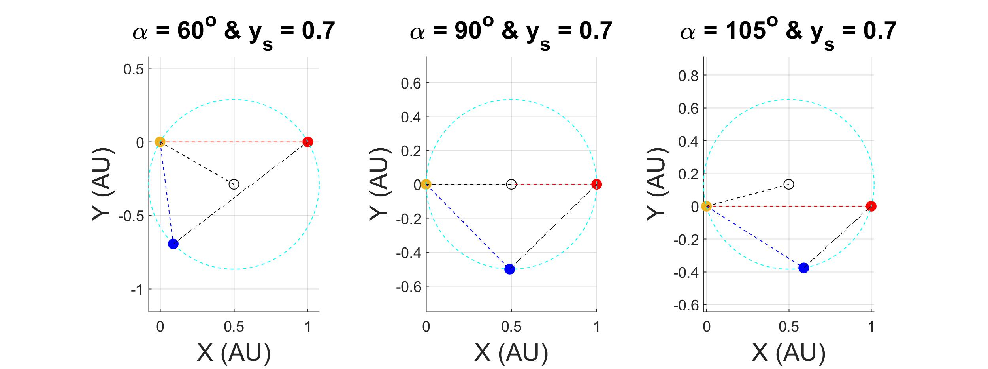
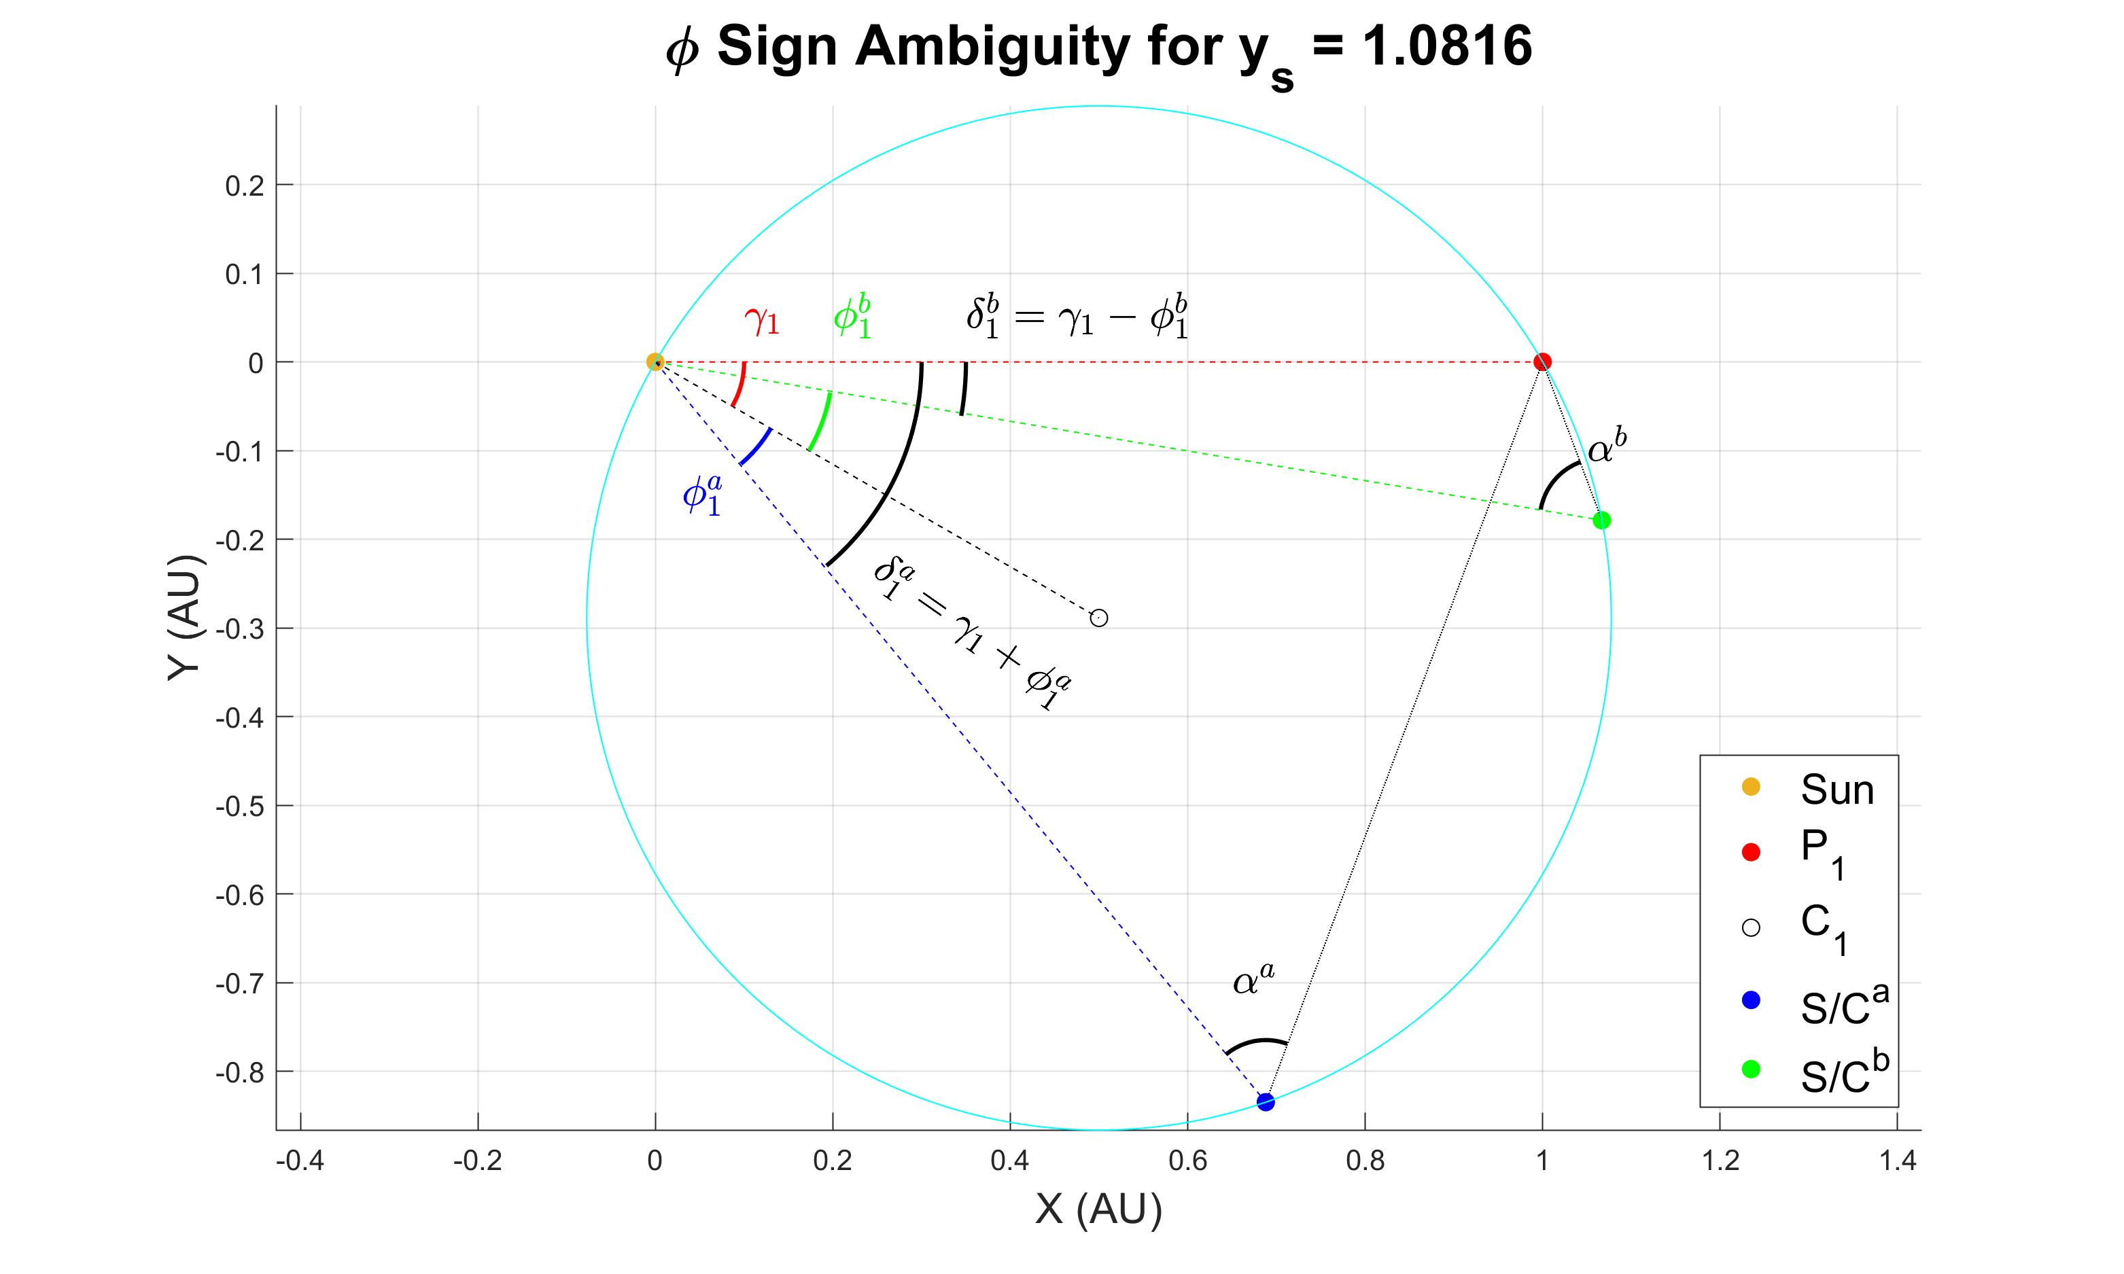

Slide 3
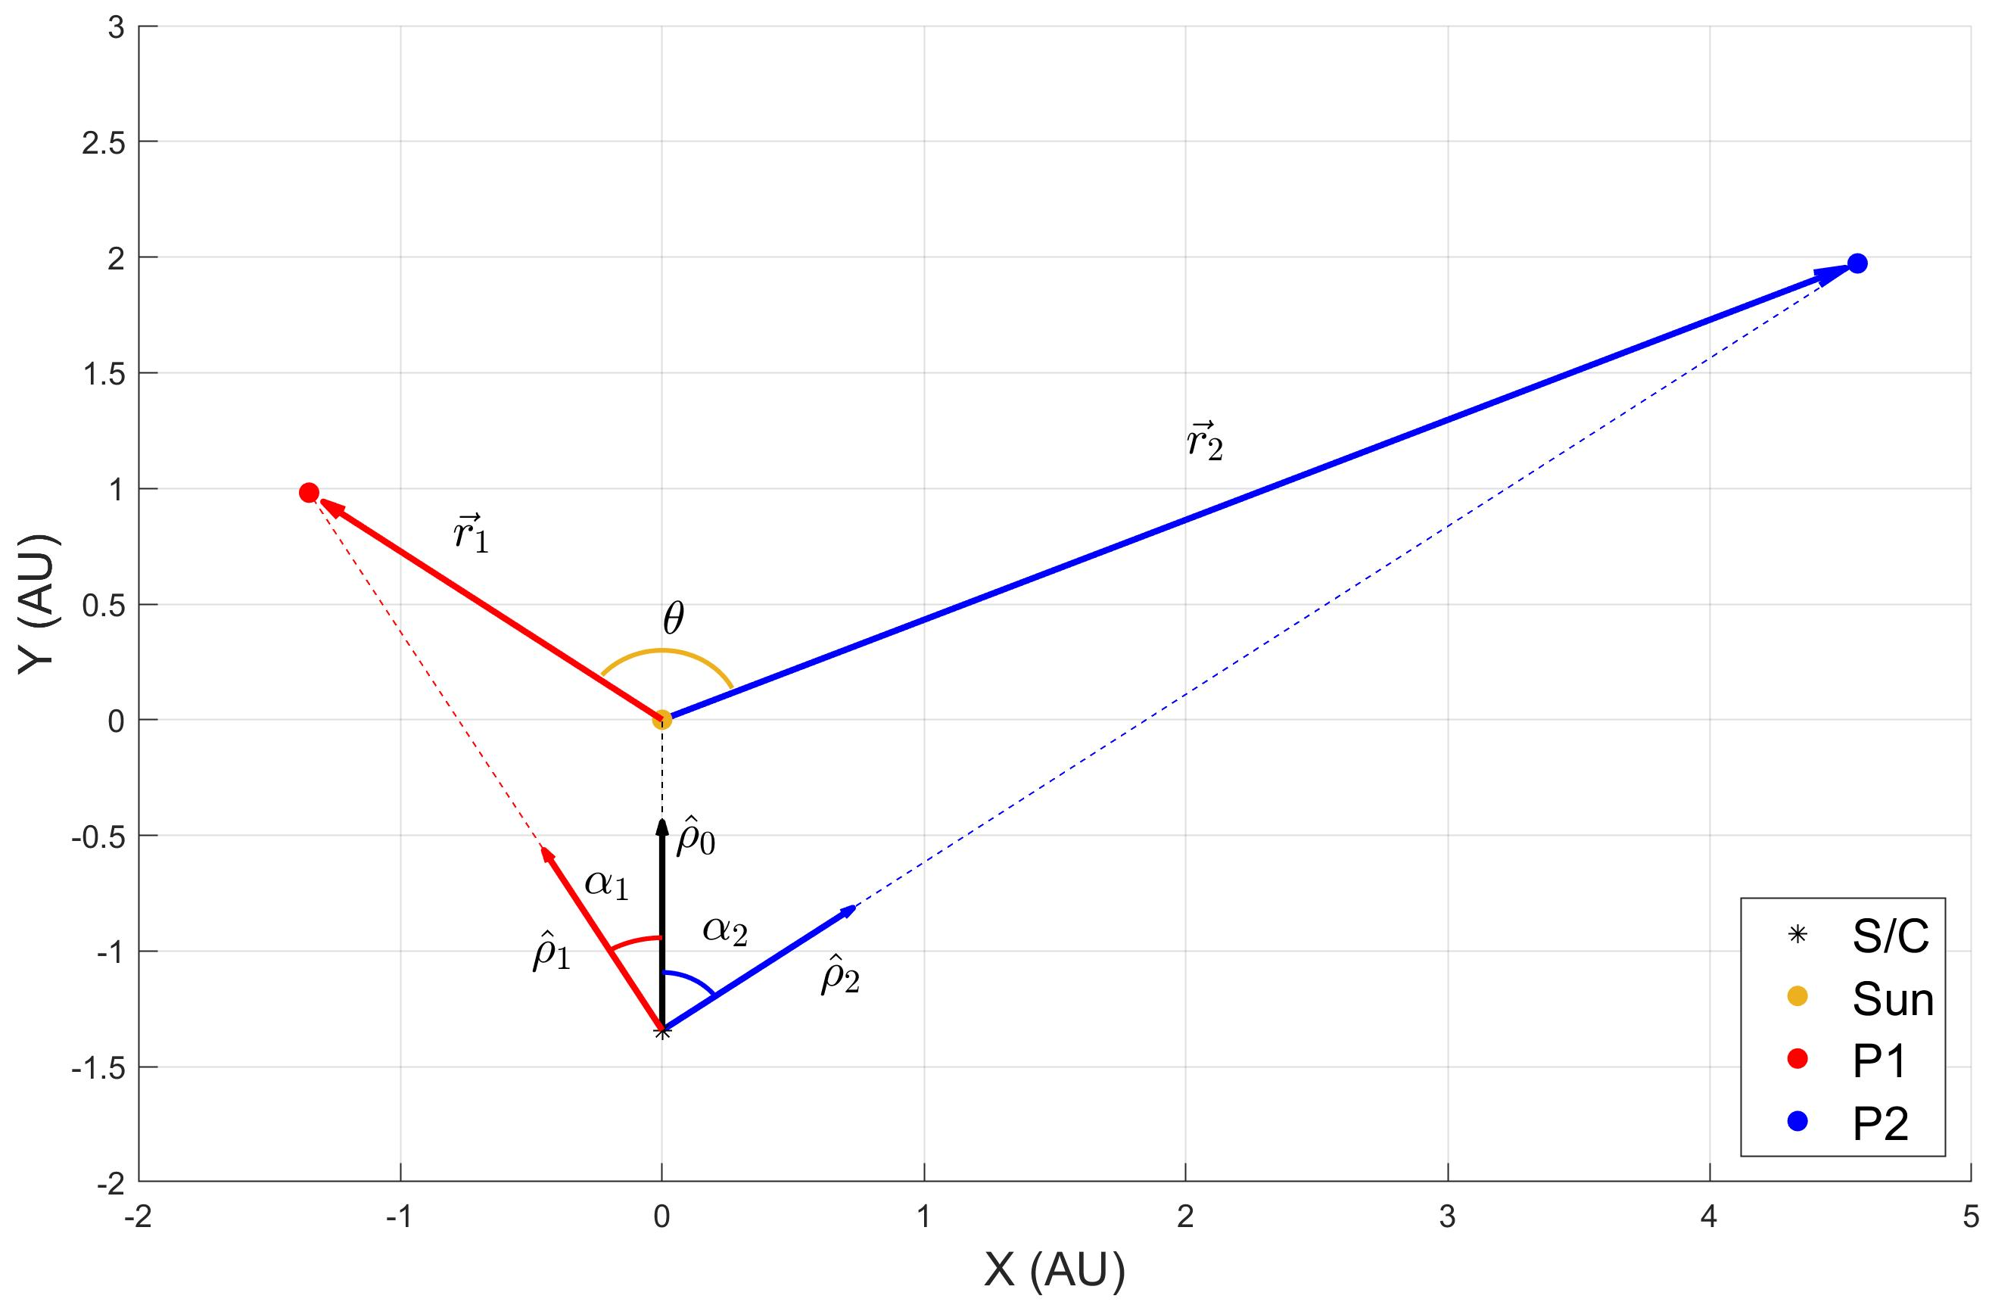
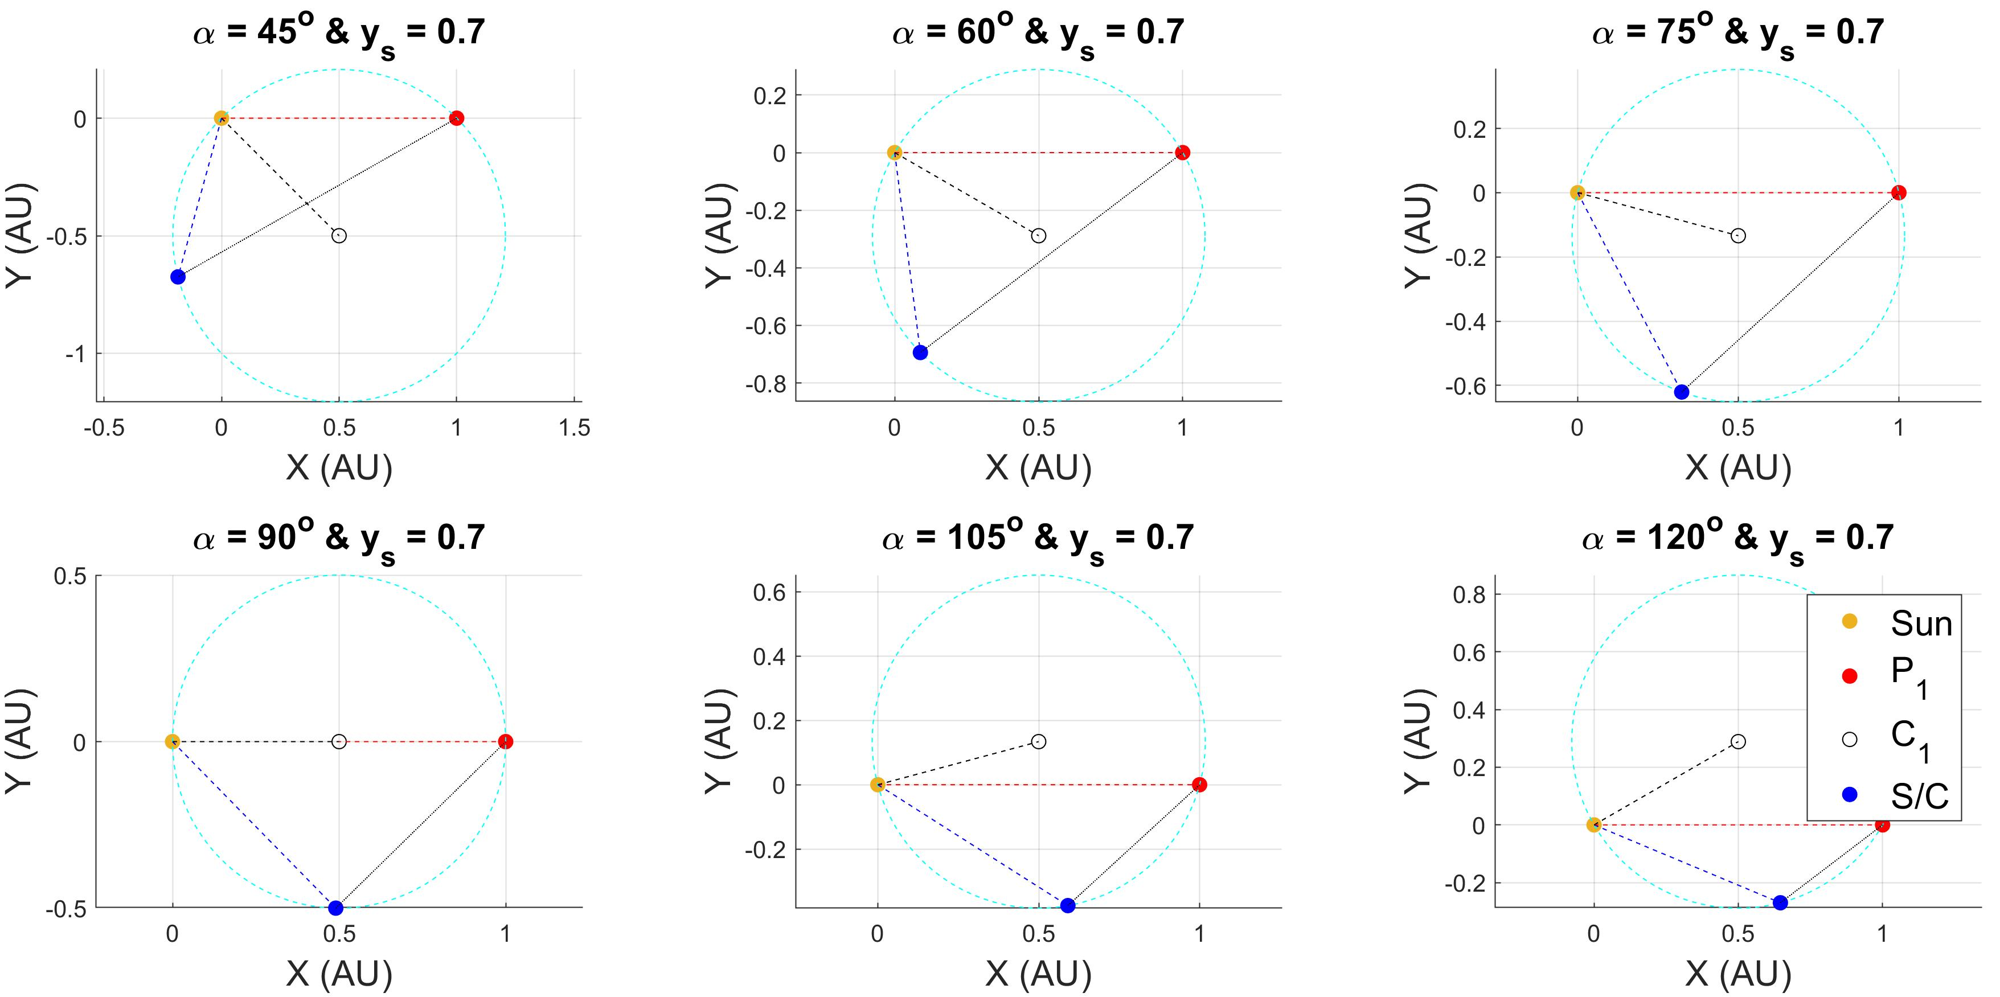
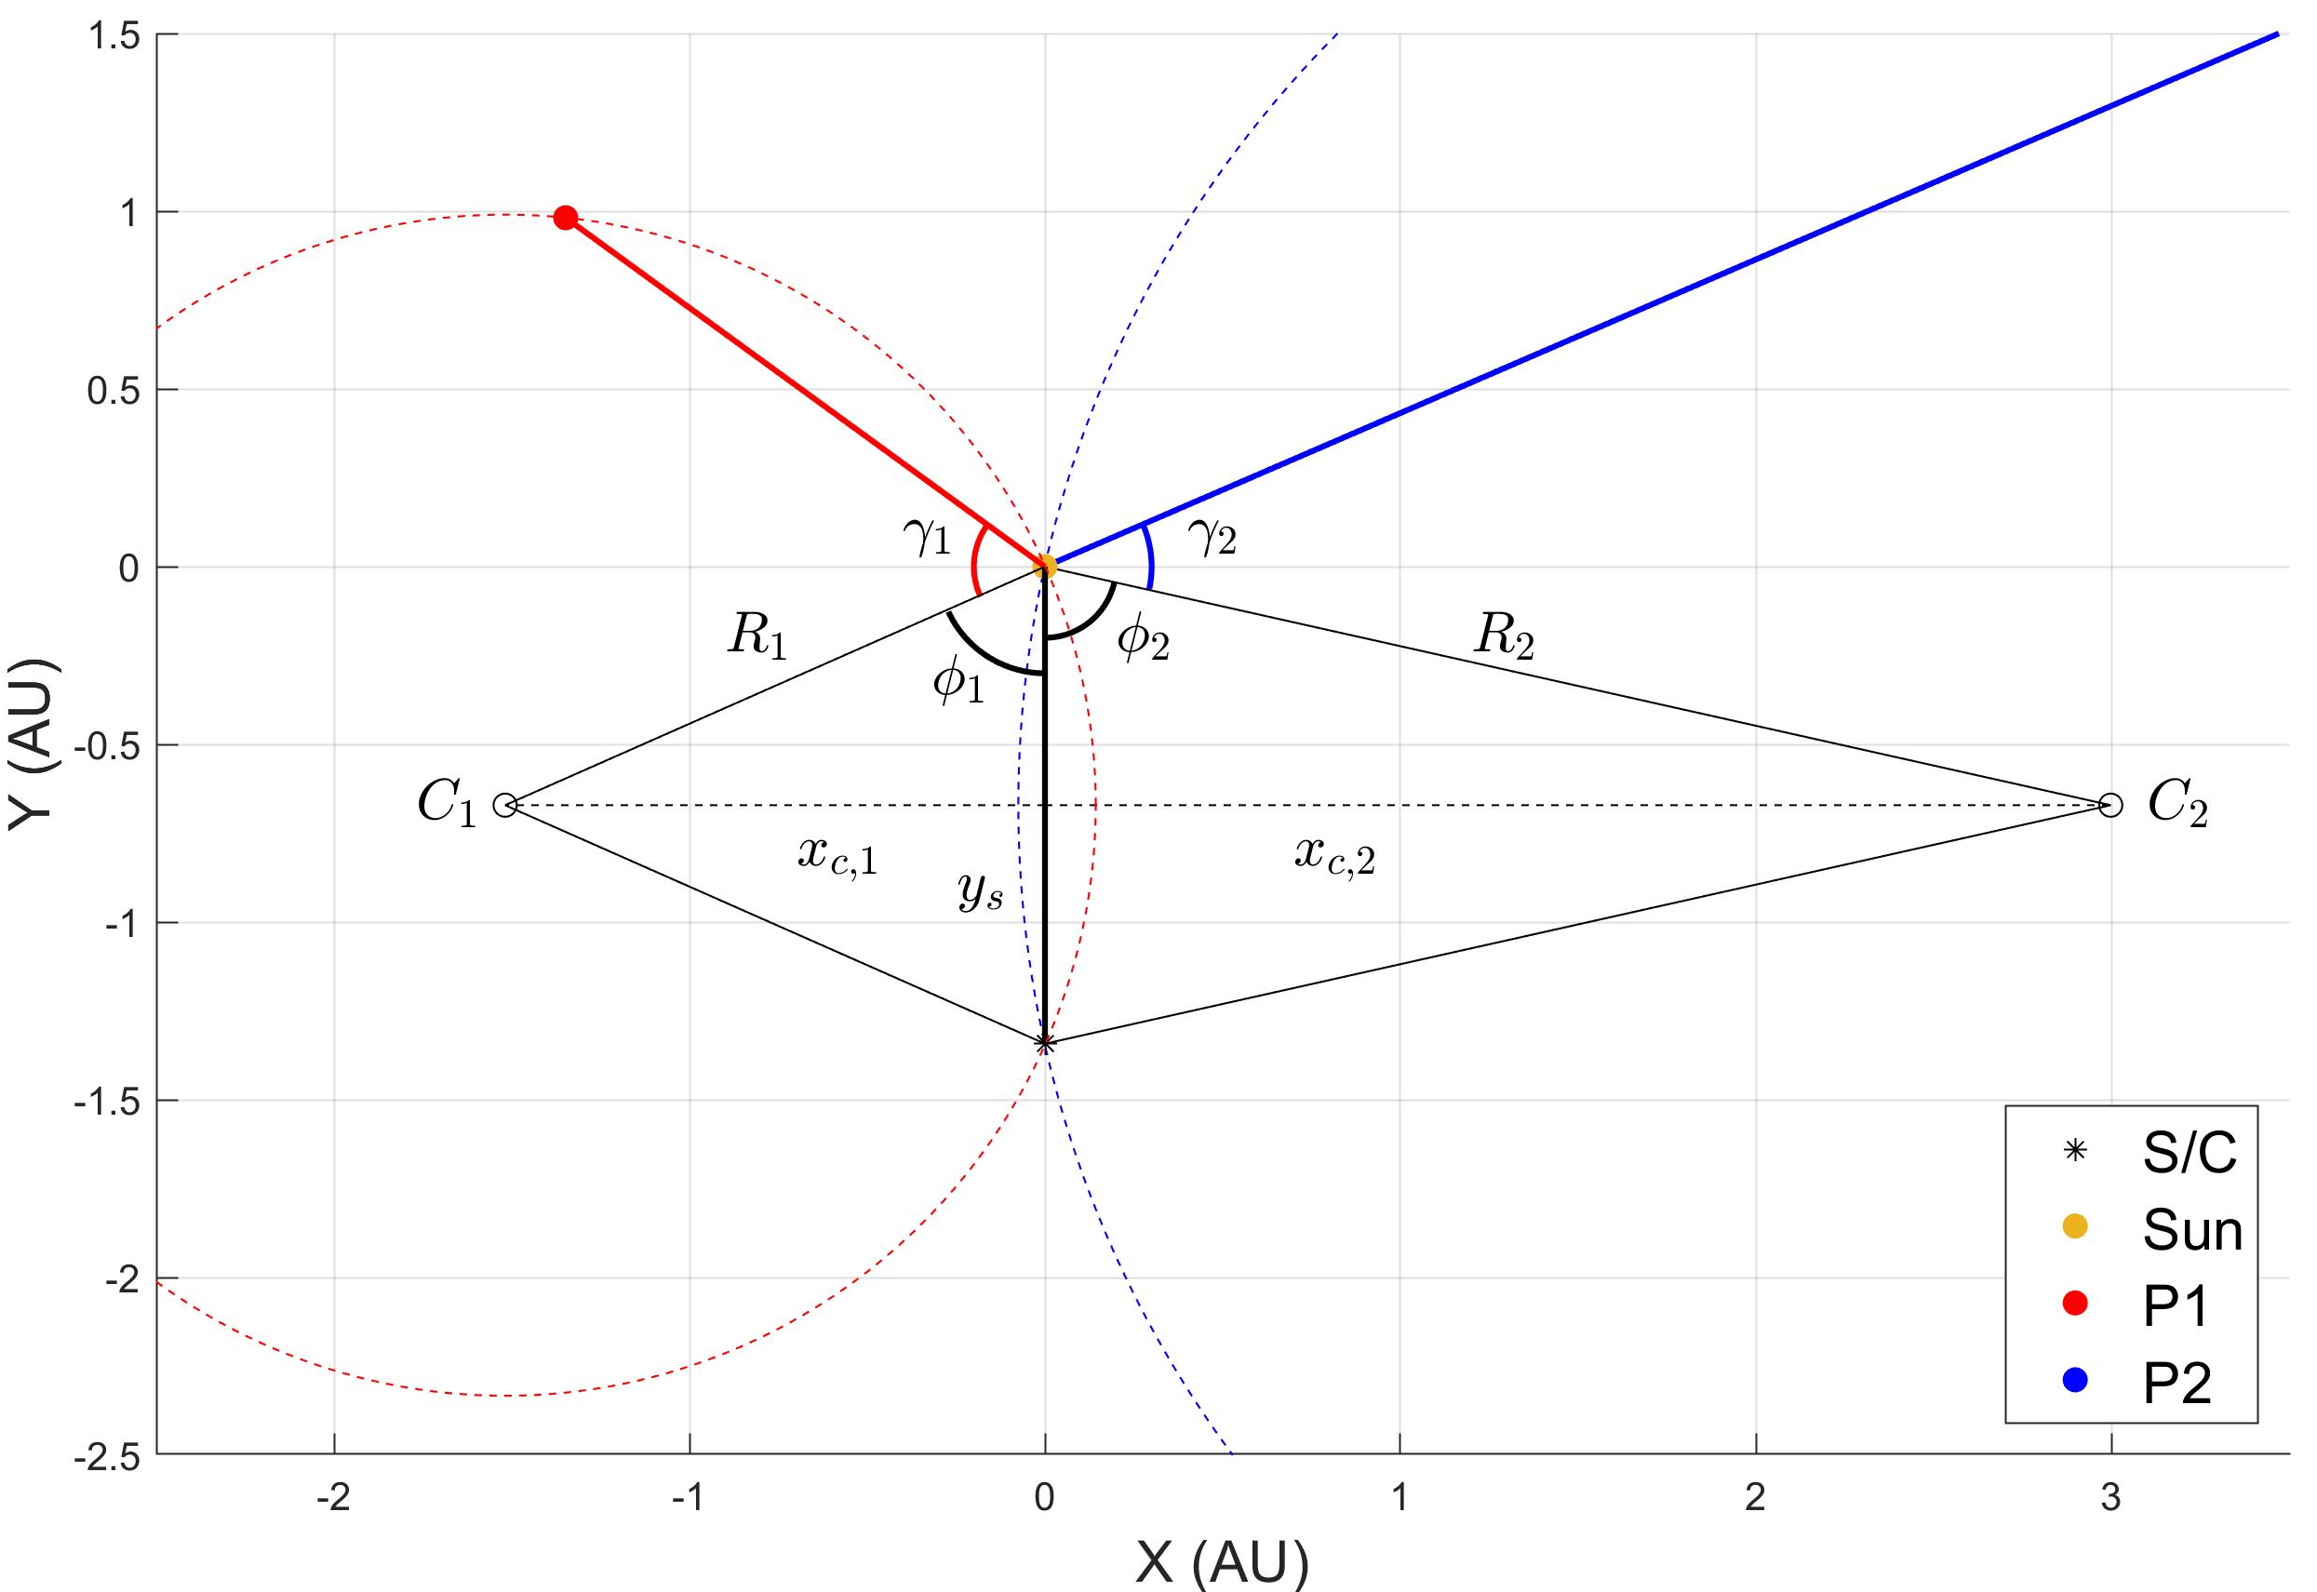
References
[1] Negrete, Aimar, and Ossama Abdelkhalik. "A geometric approach to deep space navigation using angles-only measurements." AIAA SCITECH 2024 Forum. 2024. [2] Fang, Bertrand T. "Trilateration and extension to global positioning system navigation." Journal of Guidance, Control, and Dynamics 9.6 (1986): 715-717.

Slide 4




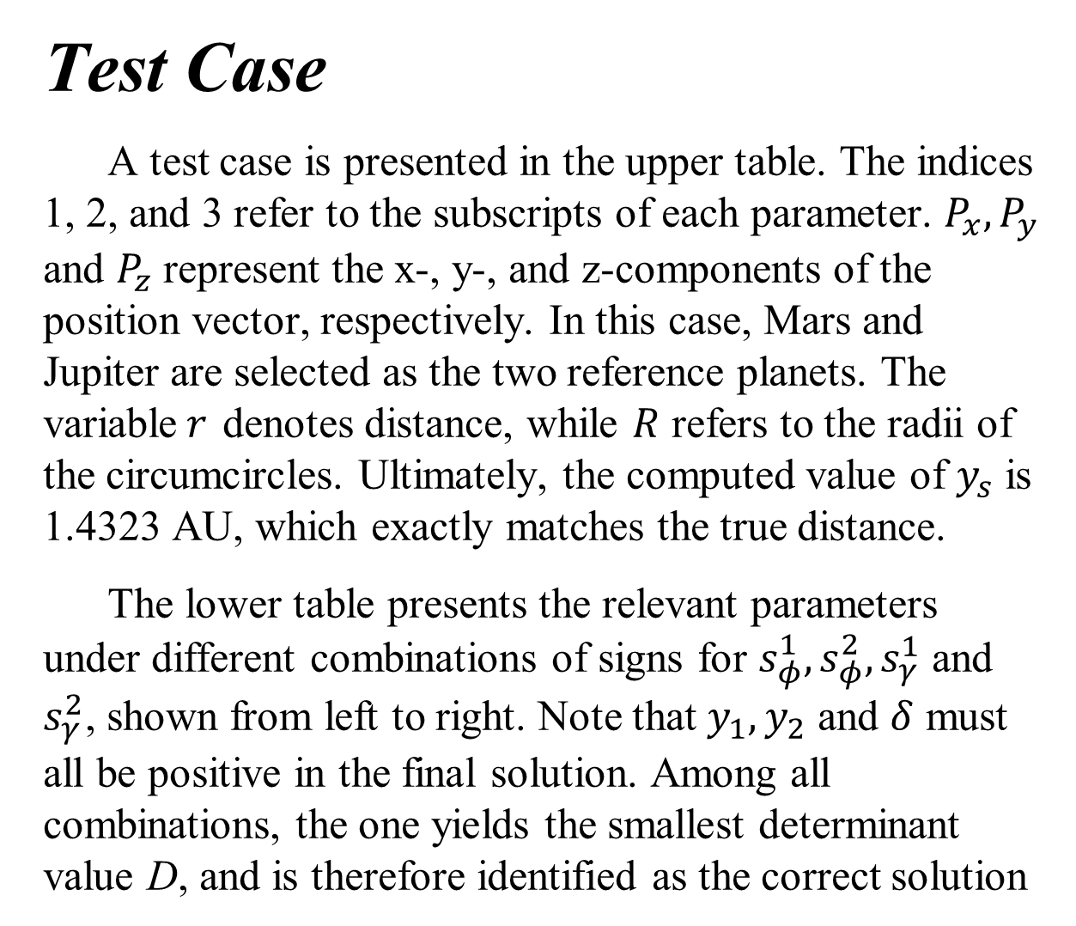








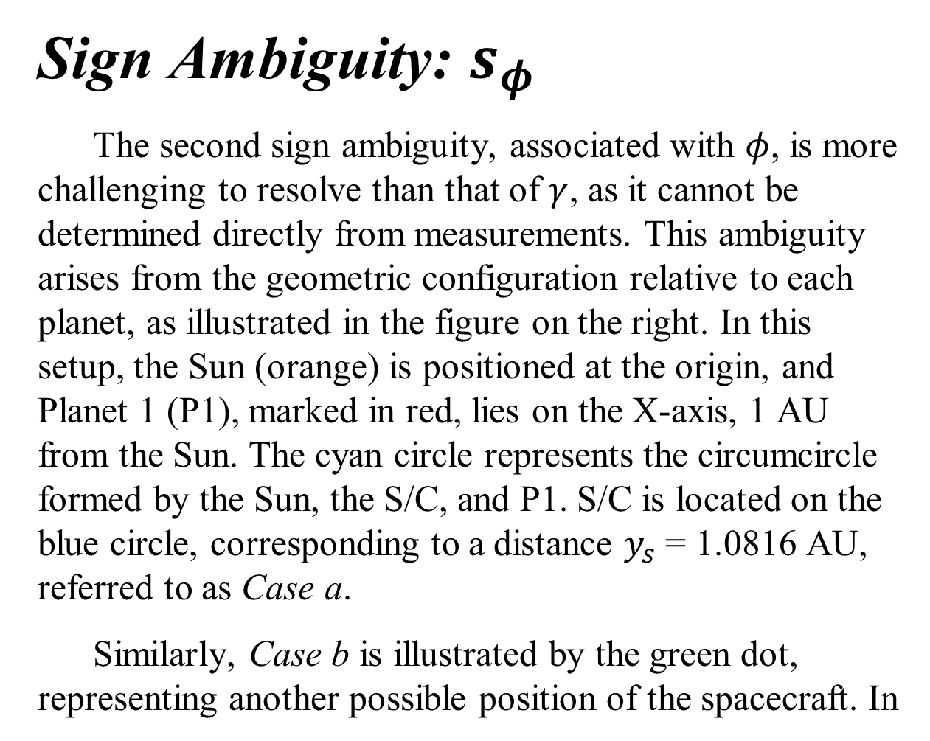








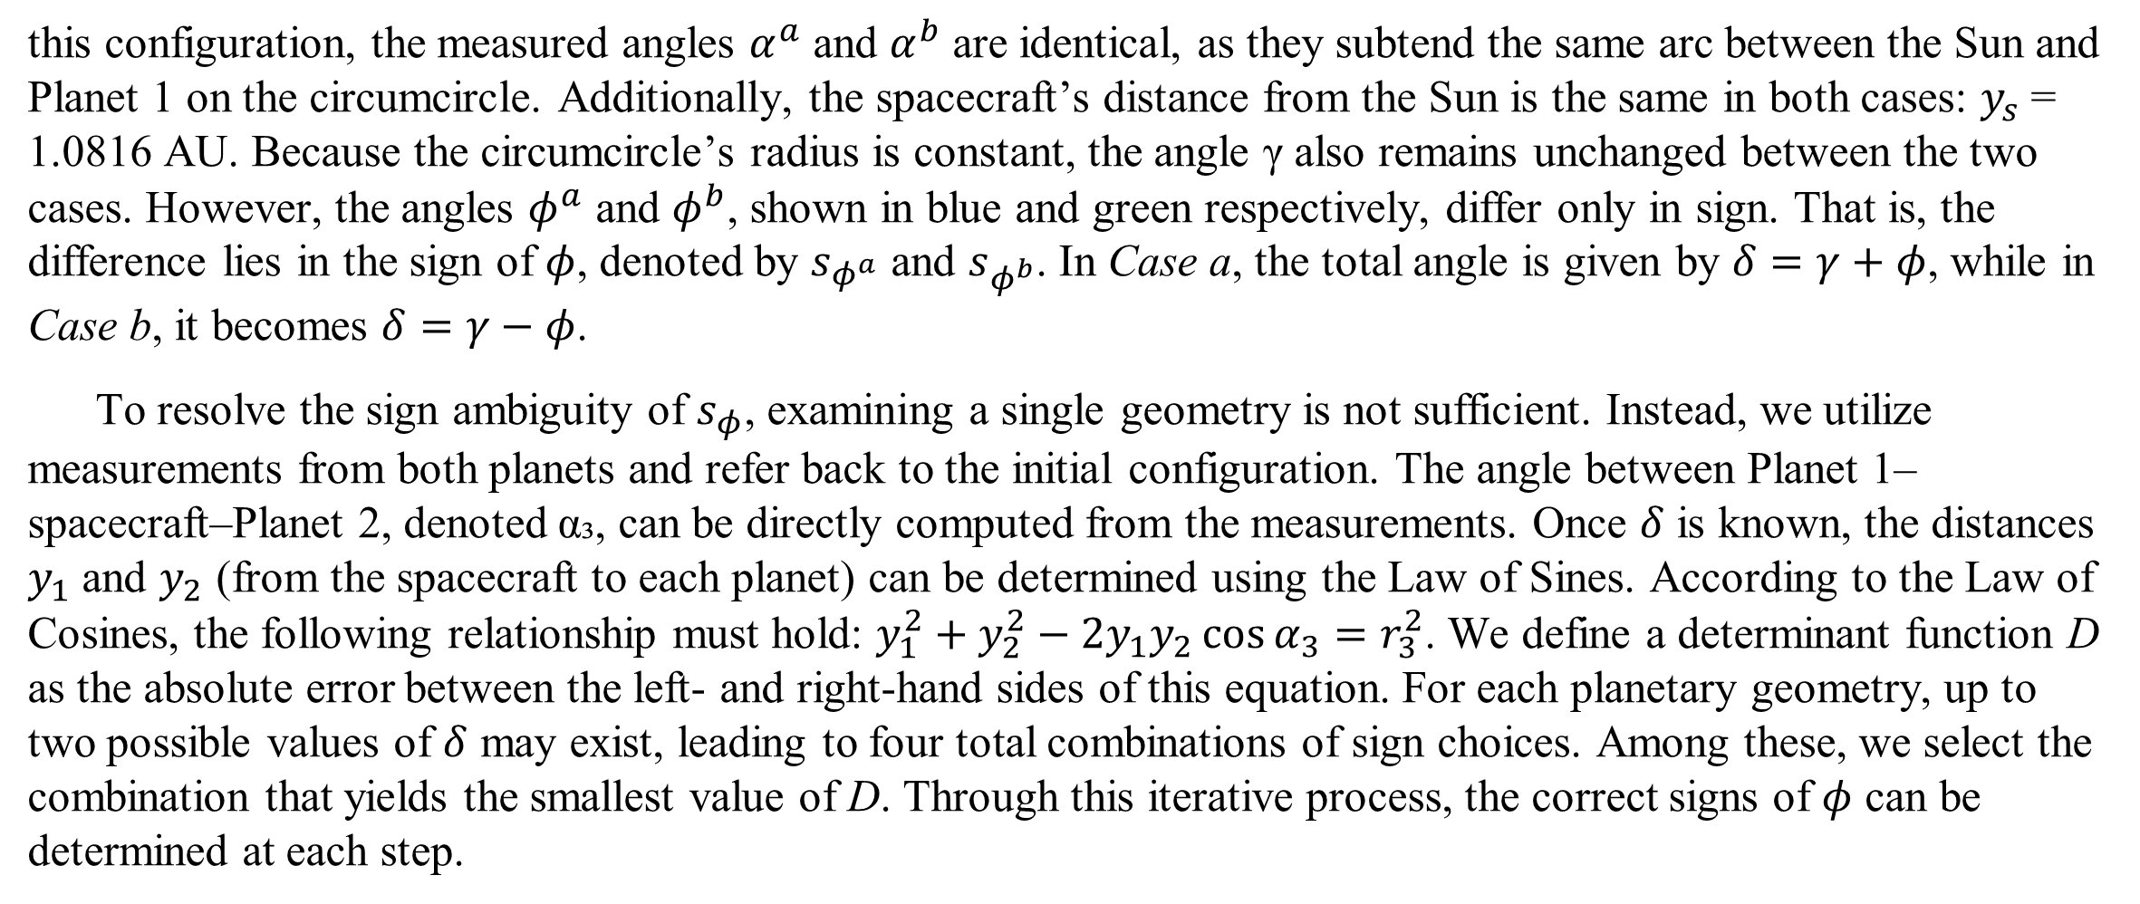

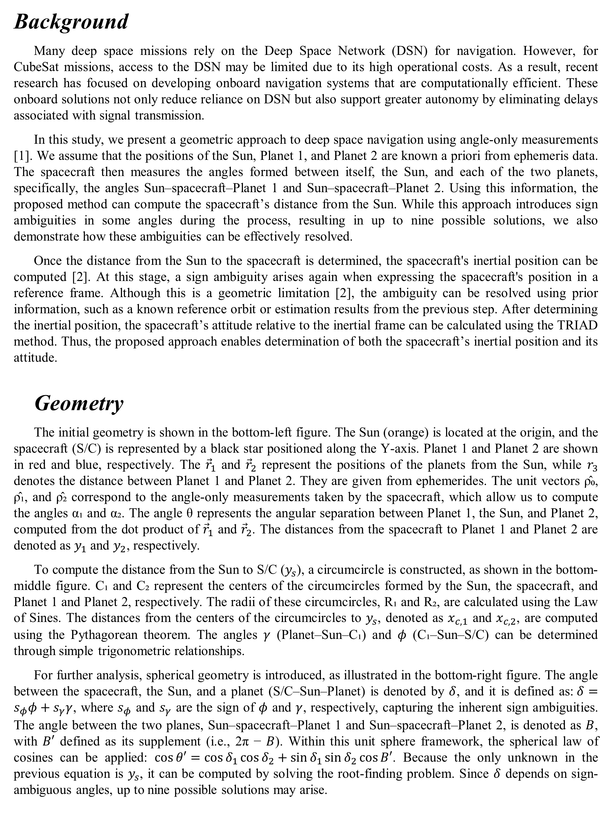


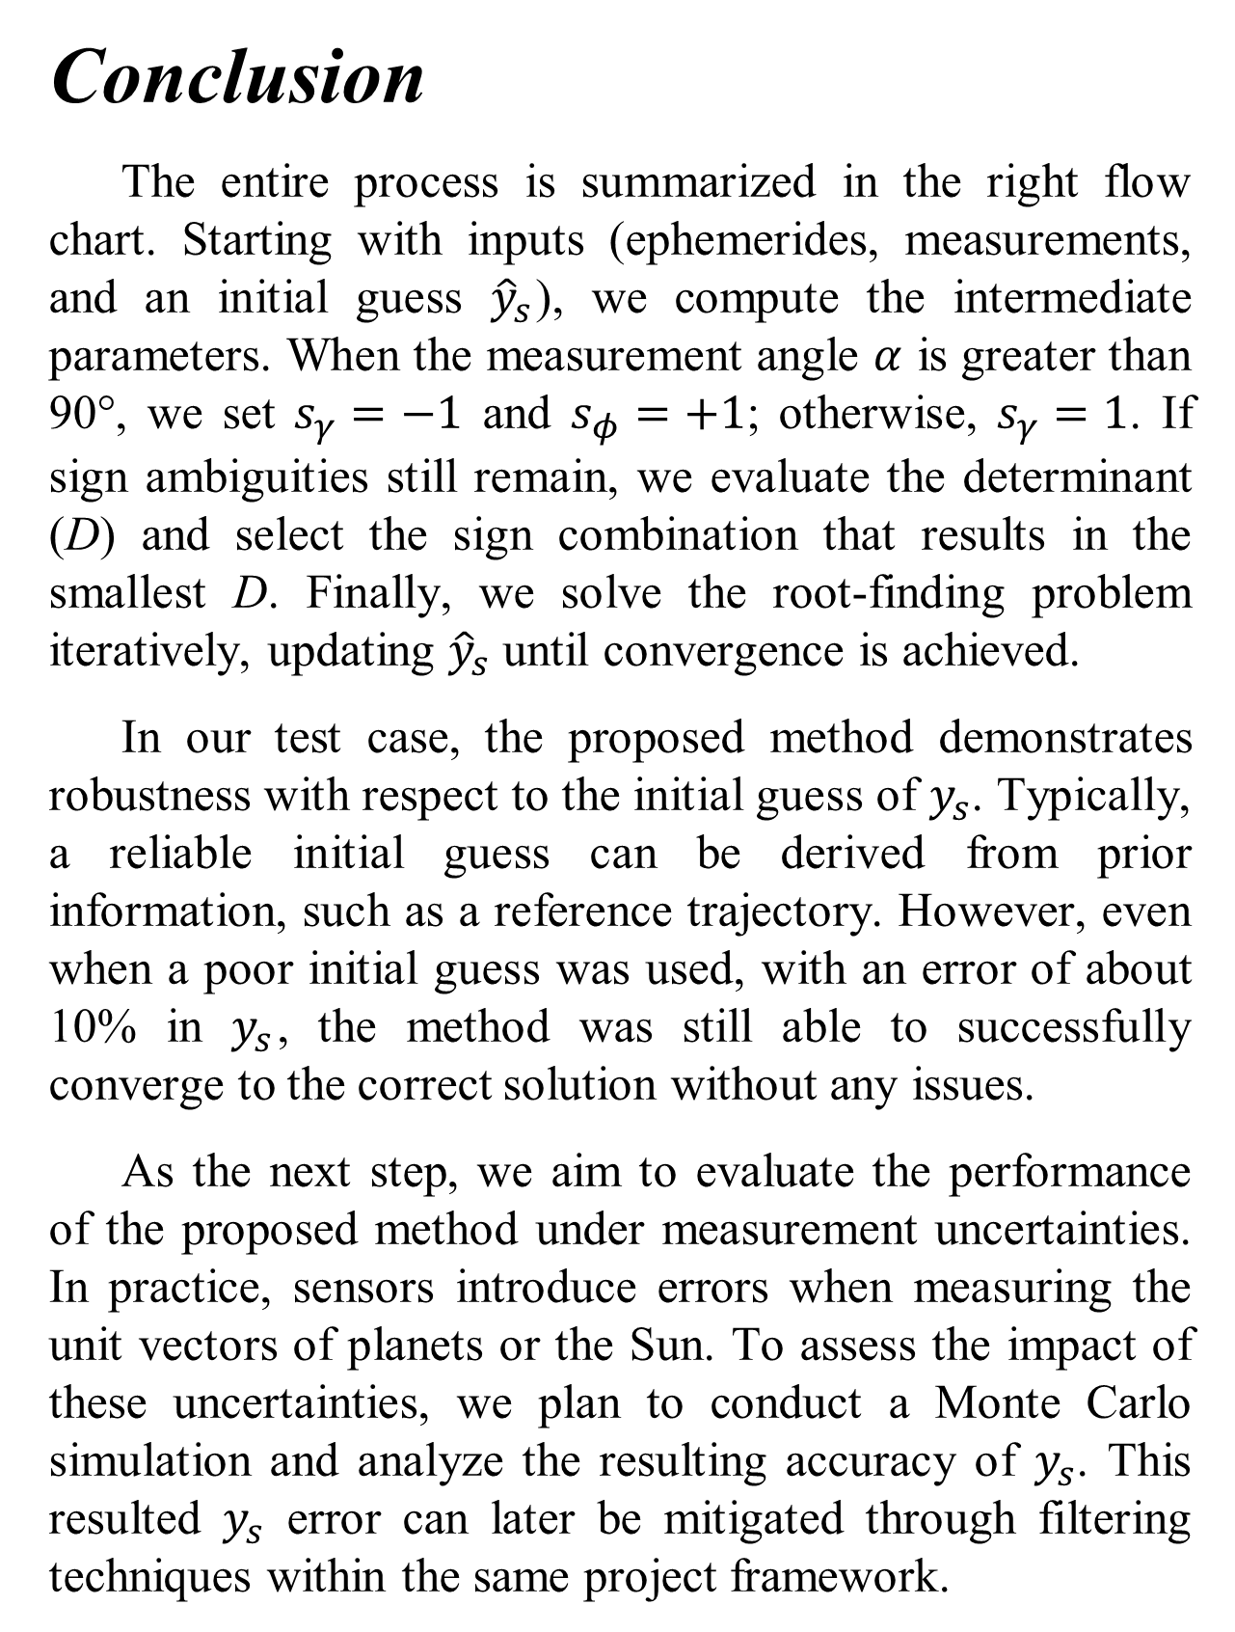


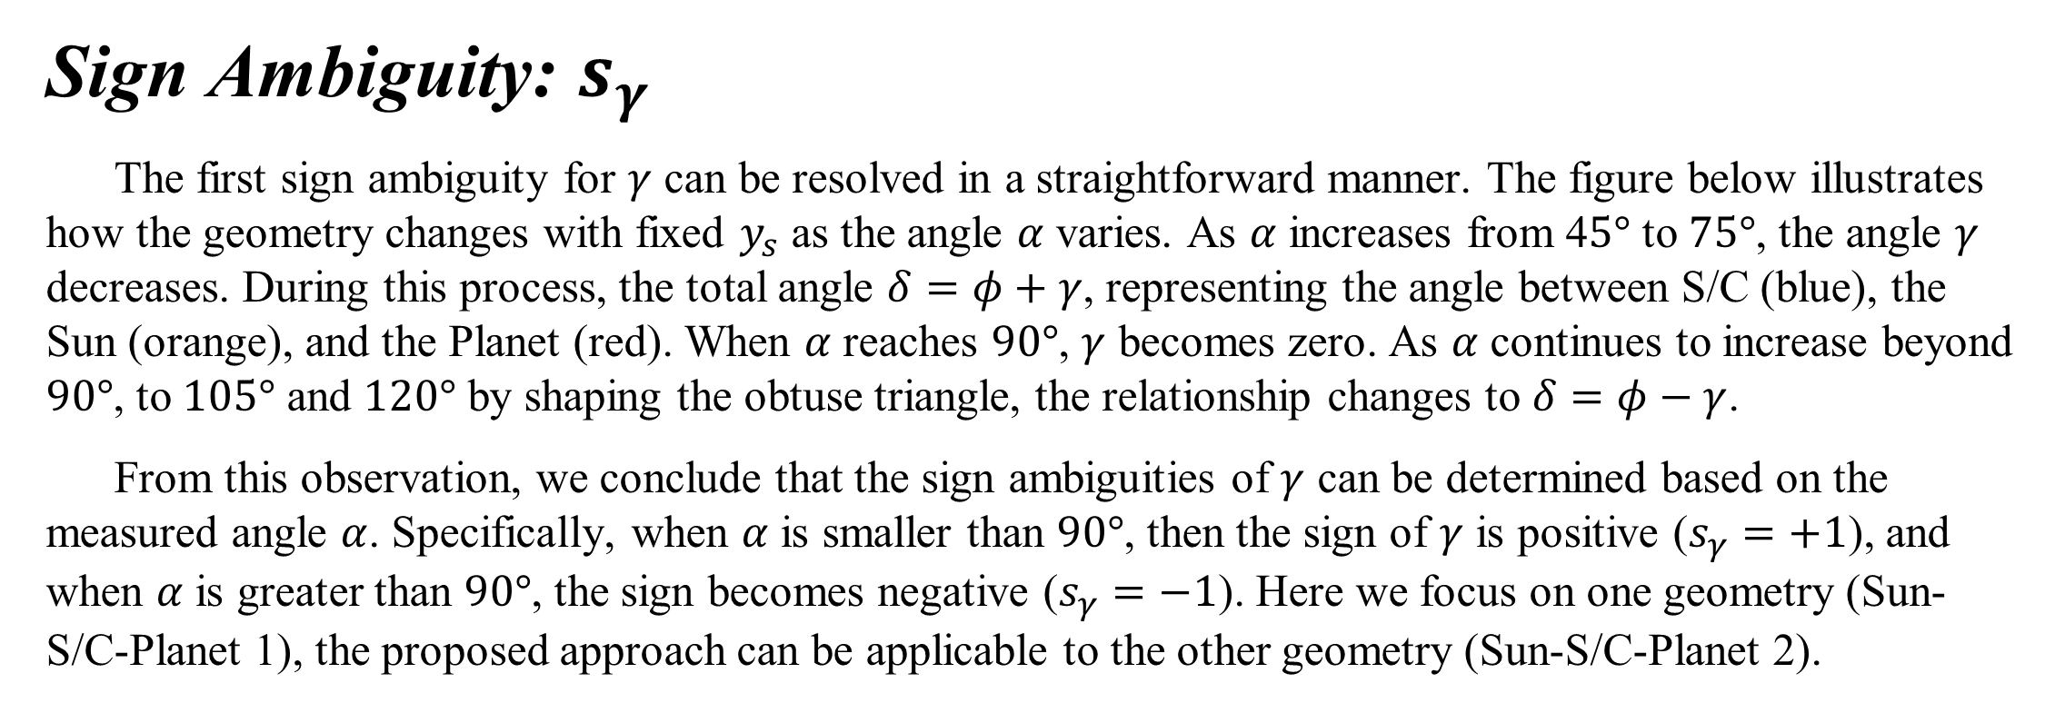
Department of Aerospace Engineering
Iowa Space Grant Consortium Student Research Symposium
April 15, 2025
Sungmoon Choi, Ph.D. Candidate Faculty Advisor: Ossama Abdelkhalik, Professor, Vance D. Coffman Faculty Chair
Ambiguity-Free Geometrical Deep Space Navigation Using Angle-Only Measurements
Background
Many deep space missions rely on the Deep Space Network (DSN) for navigation. However, for CubeSat missions, access to the DSN may be limited due to its high operational costs. As a result, recent research has focused on developing onboard navigation systems that are computationally efficient. These onboard solutions not only reduce reliance on DSN but also support greater autonomy by eliminating delays associated with signal transmission.
In this study, we present a geometric approach to deep space navigation using angle-only measurements [1]. We assume that the positions of the Sun, Planet 1, and Planet 2 are known a priori from ephemeris data. The spacecraft then measures the angles formed between itself, the Sun, and each of the two planets, specifically, the angles Sun–spacecraft–Planet 1 and Sun–spacecraft–Planet 2. Using this information, the proposed method can compute the spacecraft’s distance from the Sun. While this approach introduces sign ambiguities in some angles during the process, resulting in up to nine possible solutions, we also demonstrate how these ambiguities can be effectively resolved.
Once the distance from the Sun to the spacecraft is determined, the spacecraft's inertial position can be computed [2]. At this stage, a sign ambiguity arises again when expressing the spacecraft's position in a reference frame. Although this is a geometric limitation [2], the ambiguity can be resolved using prior information, such as a known reference orbit or estimation results from the previous step. After determining the inertial position, the spacecraft’s attitude relative to the inertial frame can be calculated using the TRIAD method. Thus, the proposed approach enables determination of both the spacecraft’s inertial position and its attitude.
Geometry
The initial geometry is shown in the bottom-left figure. The Sun (orange) is located at the origin, and the spacecraft (S/C) is represented by a black star positioned along the Y-axis. Planet 1 and Planet 2 are shown in red and blue, respectively. The ${\vec{r}}_{1}$ and ${\vec{r}}_{2}$ represent the positions of the planets from the Sun, while $r_{3}$ denotes the distance between Planet 1 and Planet 2. They are given from ephemerides. The unit vectors ρ̂₀, ρ̂₁, and ρ̂₂ correspond to the angle-only measurements taken by the spacecraft, which allow us to compute the angles α₁ and α₂. The angle θ represents the angular separation between Planet 1, the Sun, and Planet 2, computed from the dot product of ${\vec{r}}_{1}$ and ${\vec{r}}_{2}$. The distances from the spacecraft to Planet 1 and Planet 2 are denoted as $y_{1}$ and $y_{2}$, respectively.
To compute the distance from the Sun to S/C ($y_{s}$), a circumcircle is constructed, as shown in the bottom-middle figure. C₁ and C₂ represent the centers of the circumcircles formed by the Sun, the spacecraft, and Planet 1 and Planet 2, respectively. The radii of these circumcircles, R₁ and R₂, are calculated using the Law of Sines. The distances from the centers of the circumcircles to $y_{s}$, denoted as $x_{c, 1}$ and $x_{c, 2}$, are computed using the Pythagorean theorem. The angles $γ$ (Planet–Sun–C₁) and $φ$ (C₁–Sun–S/C) can be determined through simple trigonometric relationships.
For further analysis, spherical geometry is introduced, as illustrated in the bottom-right figure. The angle between the spacecraft, the Sun, and a planet (S/C–Sun–Planet) is denoted by $δ$, and it is defined as:$δ=s_{φ}φ+s_{γ}γ$, where $s_{φ}$ and $s_{γ}$ are the sign of $φ$ and $γ$, respectively, capturing the inherent sign ambiguities. The angle between the two planes, Sun–spacecraft–Planet 1 and Sun–spacecraft–Planet 2, is denoted as $B$, with $B′$ defined as its supplement (i.e., 2π − $B$). Within this unit sphere framework, the spherical law of cosines can be applied: $\cos{θ′}=\cos{δ_{1}}\cos{δ_{2}}+\sin{δ_{1}}\sin{δ_{2}}\cos{B′}$. Because the only unknown in the previous equation is $y_{s}$, it can be computed by solving the root-finding problem. Since $δ$ depends on sign-ambiguous angles, up to nine possible solutions may arise.
Sign Ambiguity: $s_{γ}$
The first sign ambiguity for $γ$ can be resolved in a straightforward manner. The figure below illustrates how the geometry changes with fixed $y_{s}$ as the angle $α$ varies. As $α$ increases from 4$5°$ to $75°$, the angle $γ$ decreases. During this process, the total angle $δ=φ+γ$, representing the angle between S/C (blue), the Sun (orange), and the Planet (red). When $α$ reaches $90°$, $γ$ becomes zero. As $α$ continues to increase beyond $90°$, to $105°$ and $120°$ by shaping the obtuse triangle, the relationship changes to $δ=φ−γ$.
From this observation, we conclude that the sign ambiguities of $γ$ can be determined based on the measured angle $α$. Specifically, when $α$ is smaller than $90°$, then the sign of $γ$ is positive ($s_{γ}=+1$), and when $α$ is greater than $90°$, the sign becomes negative ($s_{γ}=−1$). Here we focus on one geometry (Sun-S/C-Planet 1), the proposed approach can be applicable to the other geometry (Sun-S/C-Planet 2).
Sign Ambiguity: $s_{φ}$
The second sign ambiguity, associated with $φ$, is more challenging to resolve than that of $γ$, as it cannot be determined directly from measurements. This ambiguity arises from the geometric configuration relative to each planet, as illustrated in the figure on the right. In this setup, the Sun (orange) is positioned at the origin, and Planet 1 (P1), marked in red, lies on the X-axis, 1 AU from the Sun. The cyan circle represents the circumcircle formed by the Sun, the S/C, and P1. S/C is located on the blue circle, corresponding to a distance $y_{s}$ = 1.0816 AU, referred to as Case a.
Similarly, Case b is illustrated by the green dot, representing another possible position of the spacecraft. In
$$γ$$
$$γ$$
$$γ$$
$$φ$$
$$φ$$
$$φ$$
this configuration, the measured angles $α^{a}$ and $α^{b}$ are identical, as they subtend the same arc between the Sun and Planet 1 on the circumcircle. Additionally, the spacecraft’s distance from the Sun is the same in both cases: $y_{s}$ = 1.0816 AU. Because the circumcircle’s radius is constant, the angle γ also remains unchanged between the two cases. However, the angles $φ^{a}$ and $φ^{b}$, shown in blue and green respectively, differ only in sign. That is, the difference lies in the sign of $φ$, denoted by $s_{φ^{a}}$ and $s_{φ^{b}}$. In Case a, the total angle is given by $δ=γ+φ$, while in Case b, it becomes $δ=γ−φ$.
To resolve the sign ambiguity of $s_{φ}$, examining a single geometry is not sufficient. Instead, we utilize measurements from both planets and refer back to the initial configuration. The angle between Planet 1–spacecraft–Planet 2, denoted α₃, can be directly computed from the measurements. Once $δ$ is known, the distances $y_{1}$ and $y_{2}$ (from the spacecraft to each planet) can be determined using the Law of Sines. According to the Law of Cosines, the following relationship must hold: $y_{1}^{2}+y_{2}^{2}−2y_{1}y_{2}\cos{α_{3}}=r_{3}^{2}$. We define a determinant function D as the absolute error between the left- and right-hand sides of this equation. For each planetary geometry, up to two possible values of $δ$ may exist, leading to four total combinations of sign choices. Among these, we select the combination that yields the smallest value of D. Through this iterative process, the correct signs of $φ$ can be determined at each step.
$$γ$$
$$γ$$
$$φ$$
$$φ$$
$$φ$$
Test Case
A test case is presented in the upper table. The indices 1, 2, and 3 refer to the subscripts of each parameter. $P_{x}, P_{y}$ and $P_{z}$ represent the x-, y-, and z-components of the position vector, respectively. In this case, Mars and Jupiter are selected as the two reference planets. The variable$r$ denotes distance, while $R$ refers to the radii of the circumcircles. Ultimately, the computed value of $y_{s}$ is 1.4323 AU, which exactly matches the true distance.
The lower table presents the relevant parameters under different combinations of signs for $s_{φ}^{1}, s_{φ}^{2}, s_{γ}^{1}$ and $s_{γ}^{2}$, shown from left to right. Note that $y_{1}, y_{2}$ and $δ$ must all be positive in the final solution. Among all combinations, the one yields the smallest determinant value D, and is therefore identified as the correct solution
Parameters | 1 | 2 | 3
$P_{x}$ (AU) | -1.3484 | 4.5648 | 0 (S/C)
$P_{y}$ (AU) | 0.9816 | 1.9726 | -1.3423 (S/C)
$P_{z}$ (AU) | 0.0536 | -0.1103 | 0 (S/C)
r (AU) | 1.6687 | 4.974 | 5.9979
$α (°)$ | 30.143 | 54.021 | 84.162
$R$ (AU) | 1.6615 | 3.0733 | N/A
$$φ \left(°\right)$$ | 60.175 | 77.386 | N/A
$$γ \left(°\right)$$ | 59.857 | 35.979 | N/A
$y$ (AU) | 2.6873 | 5.6425 | 1.4323 ($y_{s}$)
Conclusion
The entire process is summarized in the right flow chart. Starting with inputs (ephemerides, measurements, and an initial guess ${\hat{y}}_{s}$), we compute the intermediate parameters. When the measurement angle $α$ is greater than 90°, we set $s_{γ}=−1$ and $s_{φ}=+1$; otherwise, $s_{γ}=1$. If sign ambiguities still remain, we evaluate the determinant (D) and select the sign combination that results in the smallest D. Finally, we solve the root-finding problem iteratively, updating ${\hat{y}}_{s}$ until convergence is achieved.
In our test case, the proposed method demonstrates robustness with respect to the initial guess of $y_{s}$. Typically, a reliable initial guess can be derived from prior information, such as a reference trajectory. However, even when a poor initial guess was used, with an error of about 10% in $y_{s}$, the method was still able to successfully converge to the correct solution without any issues.
As the next step, we aim to evaluate the performance of the proposed method under measurement uncertainties. In practice, sensors introduce errors when measuring the unit vectors of planets or the Sun. To assess the impact of these uncertainties, we plan to conduct a Monte Carlo simulation and analyze the resulting accuracy of $y_{s}$. This resulted $y_{s}$ error can later be mitigated through filtering techniques within the same project framework.
Inputs: $R_{1}, R_{2}, {\hat{ρ}}_{0},{\hat{ρ}}_{1},{\hat{ρ}}_{2}, {\hat{y}}_{s}$
Compute: $α_{i}, R_{i}, x_{c, i}$
Compute: $φ, γ$
Yes
$$α>90°$$
No
$$s_{φ}^{1}s_{φ}^{2}s_{γ}^{1}s_{γ}^{2}$$ | -, -, +, + | +, -, +, + | -, +, +, + | +, +, +, +
$$δ_{1} \left(°\right)$$ | -6.3187 | 126.03 | -6.3187 | 126.03
$$δ_{2} \left(°\right)$$ | -41.407 | 113.36 | -41.407 | 113.36
$y_{1}$ (AU) | -0.3657 | 2.6873 | -0.3657 | 2.6873
$y_{2}$ (AU) | -4.0654 | -4.0654 | 5.6425 | 5.6425
$$D$$ | -19.616 | -10.004 | -3.5832 | -3.55e-14
$$s_{γ}=−1, s_{φ}=+1$$
$$s_{γ}=1$$
$s_{φ_{i}}$ fixed?
No
Yes
Compute: $y_{1}, y_{2}, r_{3}, α_{3}$
$$r_{3}$$
Compute: $D$
Choose signs to minimize D
Solve root-finding
Update: ${\hat{y}}_{s}$
$$y_{1}$$
$$y_{2}$$
No
Stop?
Yes
End: $y_{s}$
References
[1] Negrete, Aimar, and Ossama Abdelkhalik. "A geometric approach to deep space navigation using angles-only measurements." AIAA SCITECH 2024 Forum. 2024. [2] Fang, Bertrand T. "Trilateration and extension to global positioning system navigation." Journal of Guidance, Control, and Dynamics 9.6 (1986): 715-717.
This project/material is based upon work supported by NASA Award No. 24-2024EPSCoR-0024.

